Slide 1

Changes in Fuel Loadings at Utah SageSTEP Sites

Slide 2
Overview
Fuels Guide and Photo Series of Masticated sites
Fuel Treatment Effectiveness—Stansbury Case Study
Changes in Fuel Loading and Treatment Longevity

Slide 3
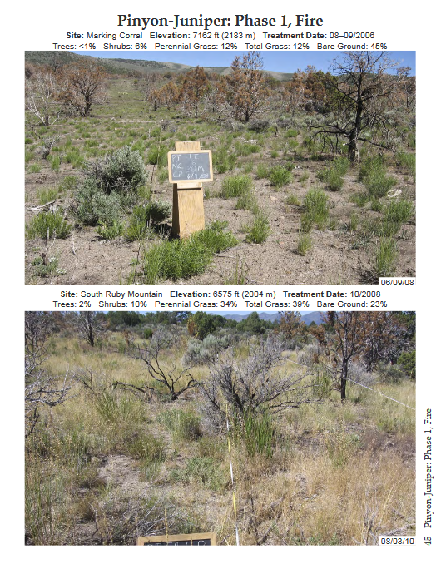
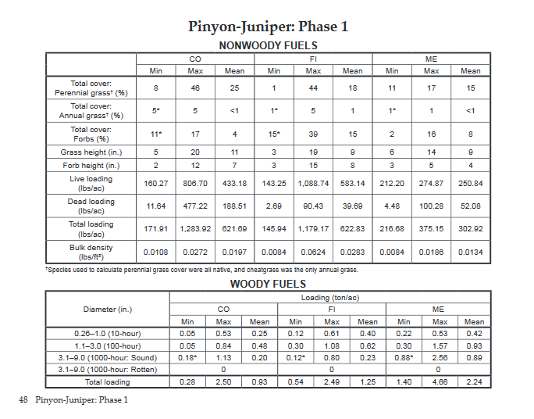
Fuels Guide
Fuel loadings, cover, density, photos, trends
Printing quote from Allegra Printing and Imaging:
500 copies: $15,890
1000 copies: $21,086
Notes:
This 10-year post-treatment fuel guide will pair fuel loadings and cover and density estimates by functional group with pictures to help land managers quickly estimate characteristics of treated and untreated pinyon-juniper woodlands and sagebrush steppe ecosystems.
Similar fuel guides were created for SageSTEP sites pre-treatment and two years post-treatment.

Slide 4
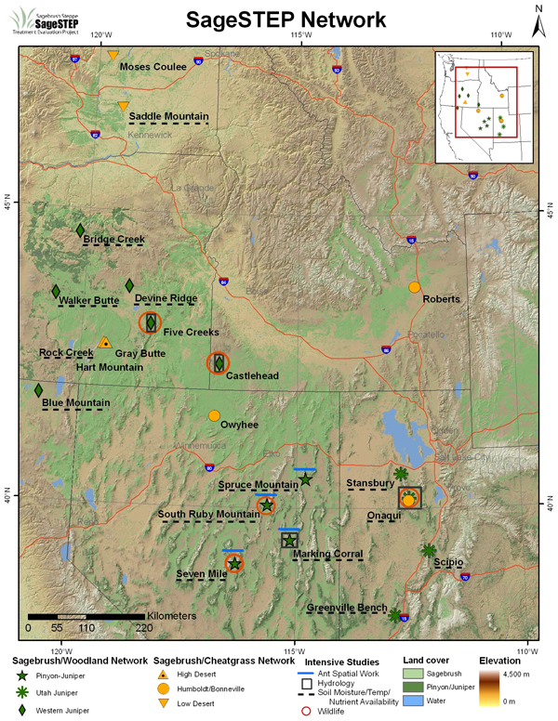
SageSTEP sites
Fuels guide covers sagebrush and woodland networks
Rest of presentation will focus on the four woodland sites in Utah
Notes:
Data from the 17 SageSTEP sites that have not burned, will be summarized in the fuels guide. It will cover both the sagebrush and woodland site types.
For the rest of the presentation, we will focus on the four woodland sites in Utah.

Slide 5
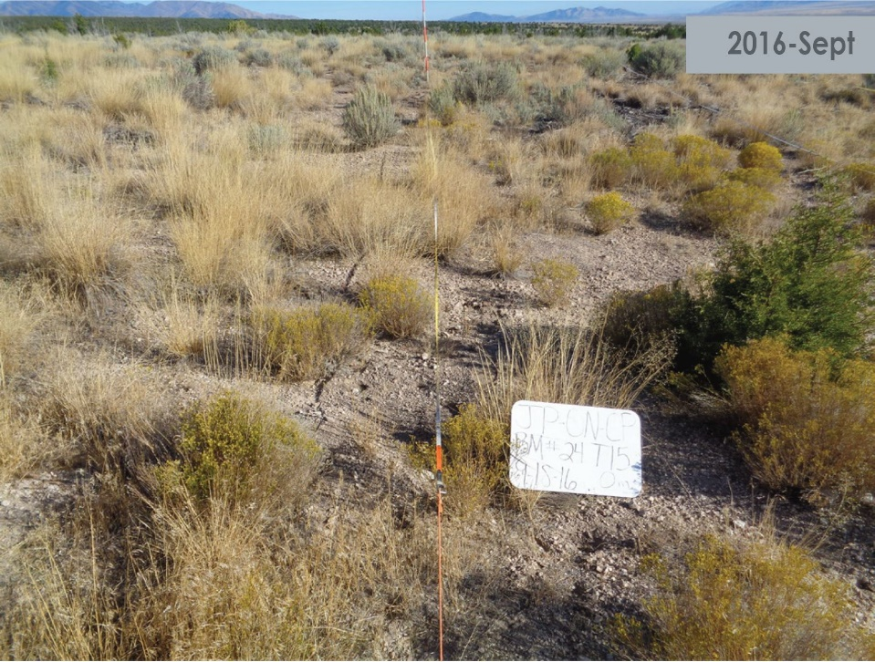
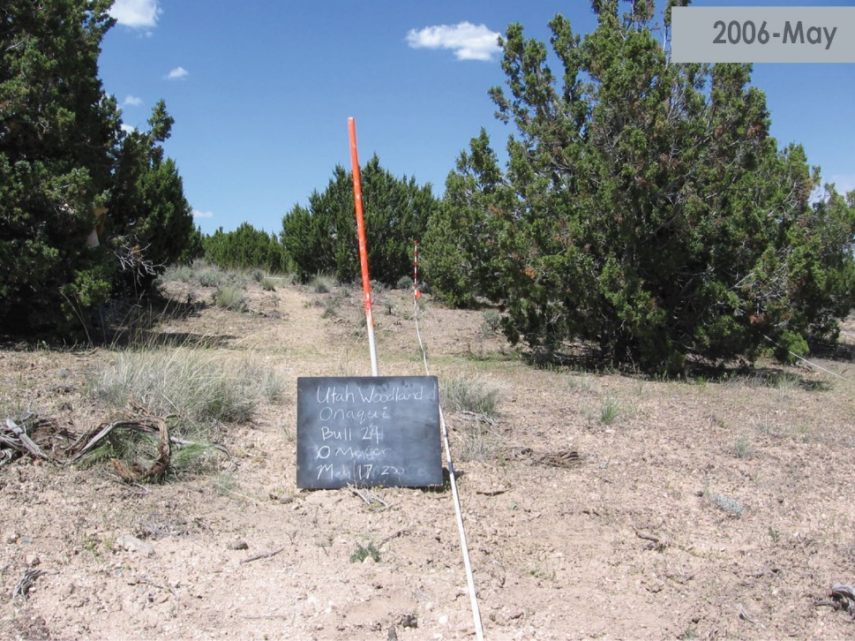
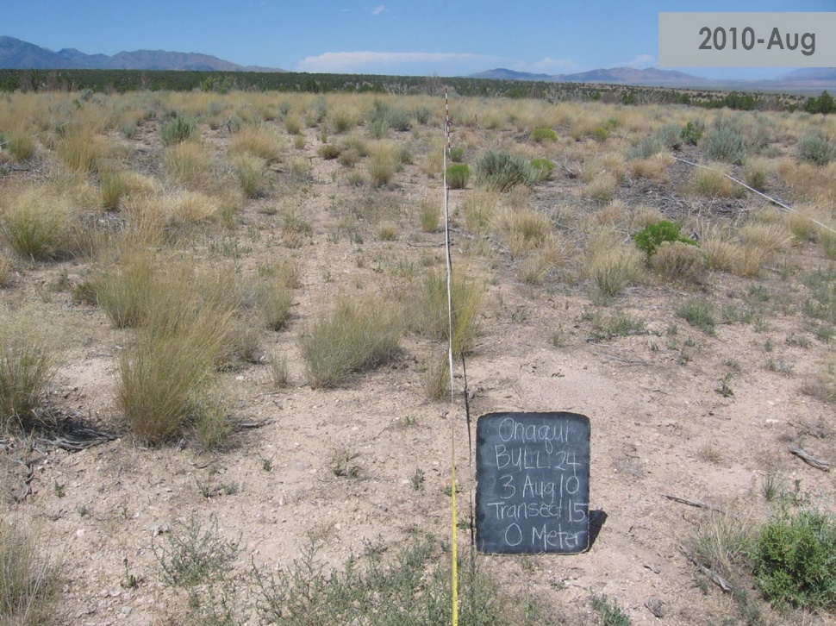
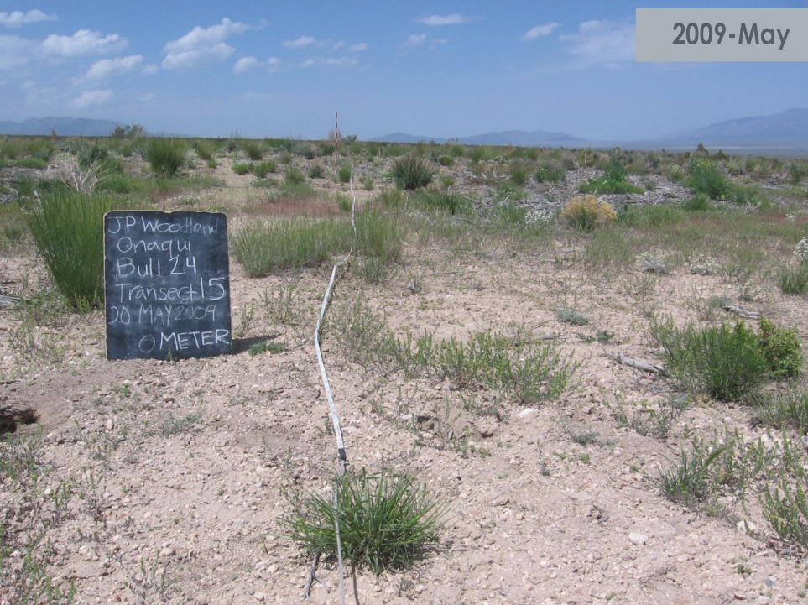
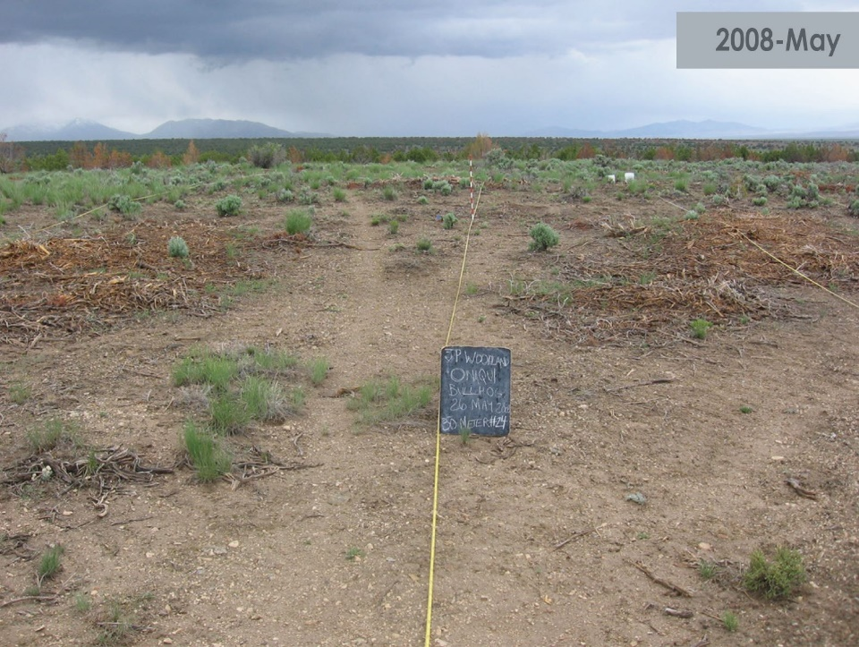
Onaqui Mastication
Notes:
2008—small juniper foreground, lots of bare ground
--sagebrush very small
--pay attention to masticated fuel beds

Slide 6
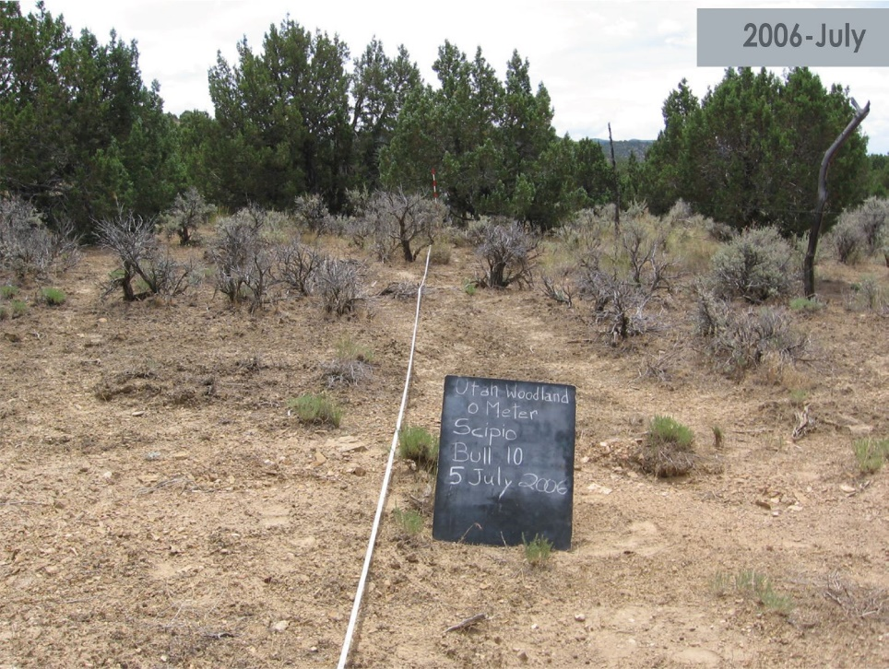
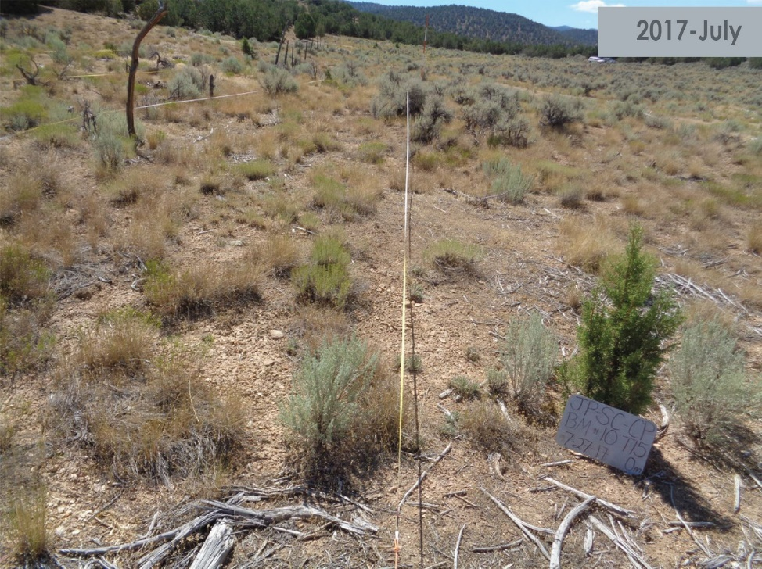
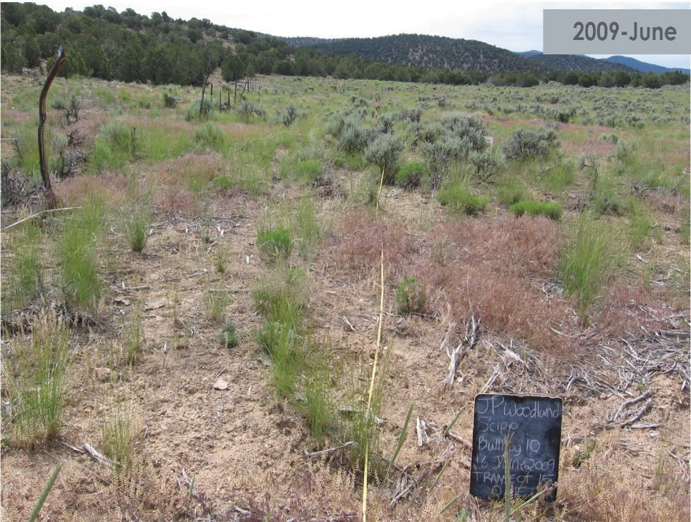
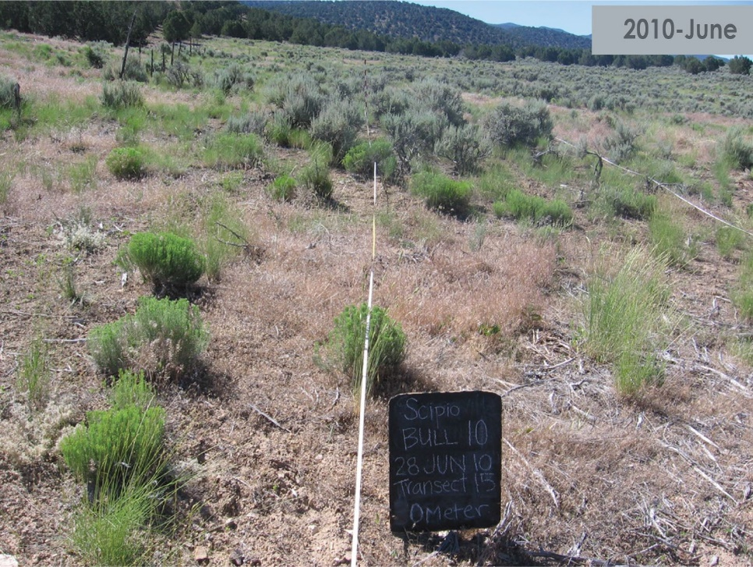
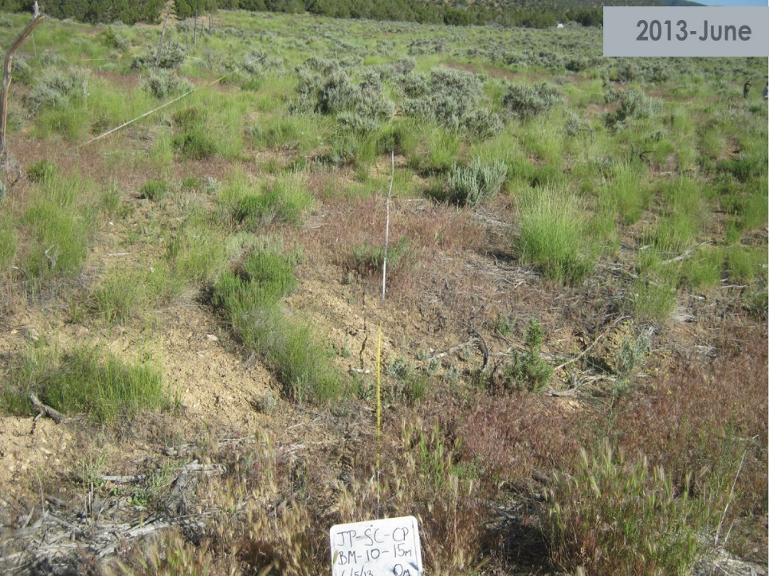
Scipio Mastication
Notes:
Pre-treatment—dead sagebrush, lots of bare ground, few perennial grasses
--photo taken from opposite side of plot
2013 – juniper in foreground, sagebrush seedlings, perennial grasses filling in
2017 – juniper in foreground

Slide 7
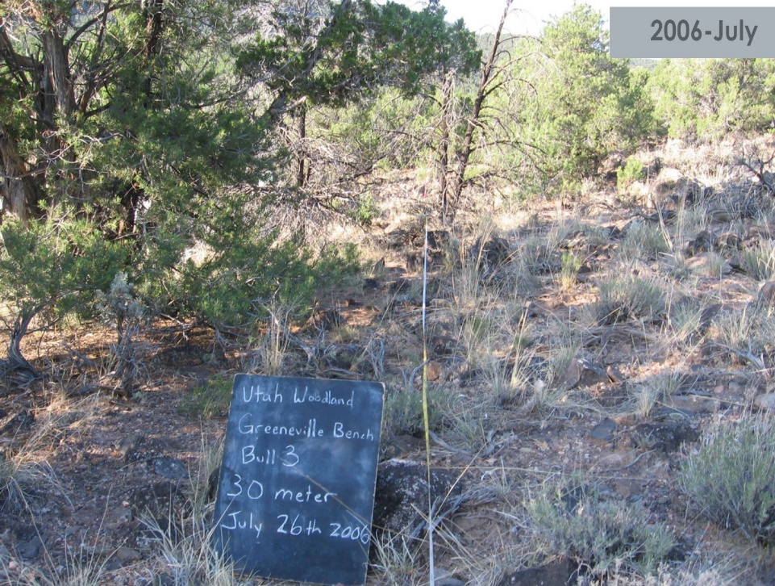
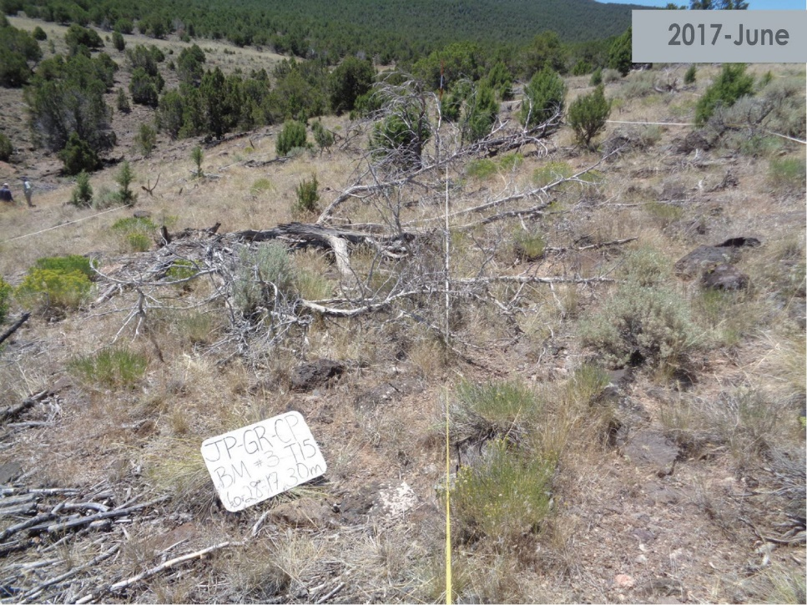
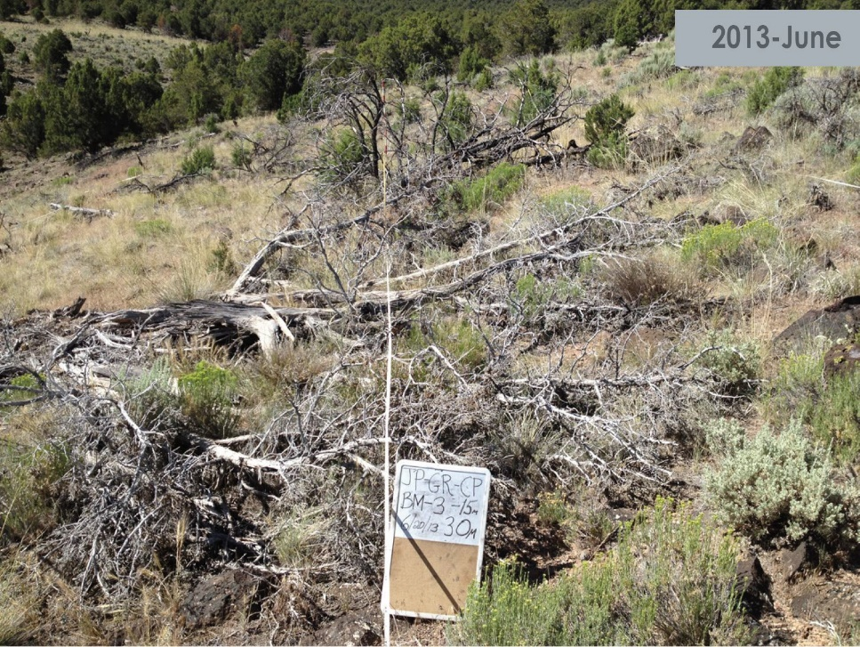
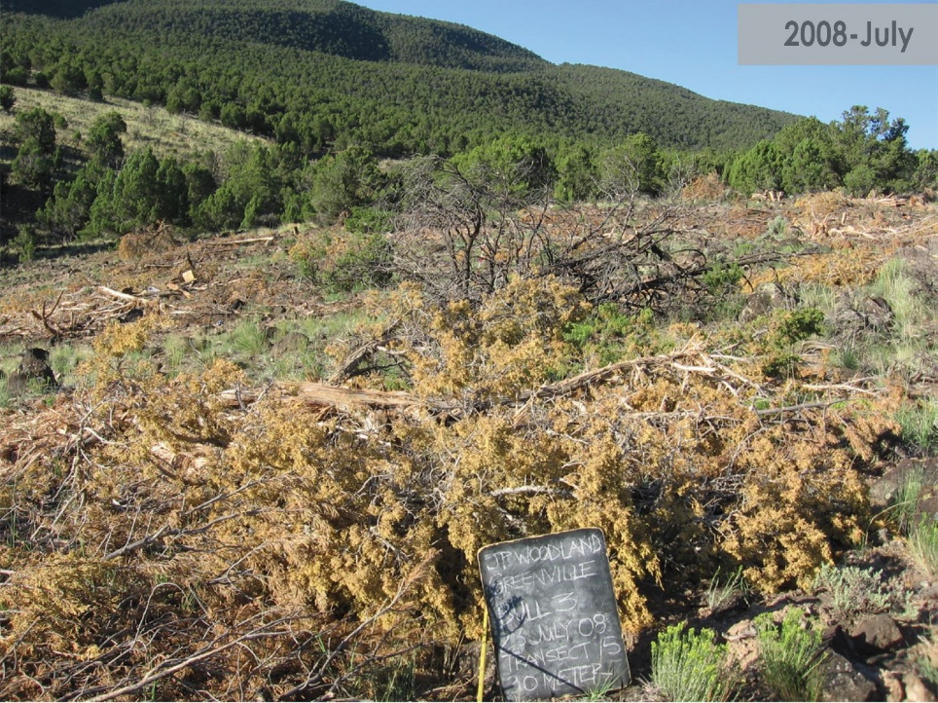
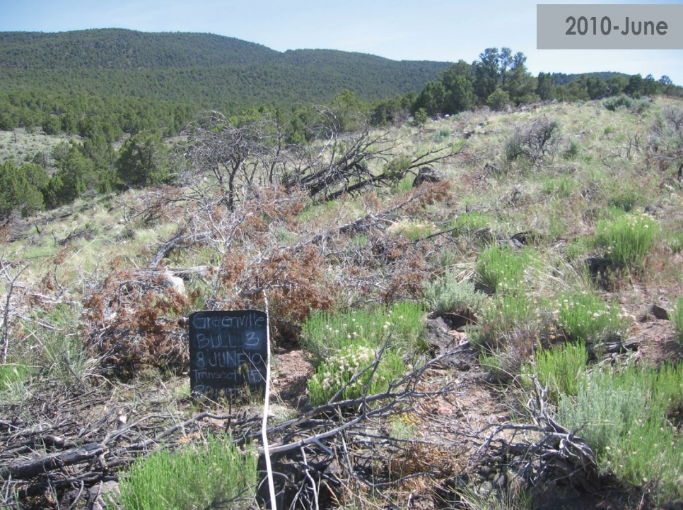
Greenville Bench Mastication
Notes:
Contractor did not shred trees as completely as other sites
2013 + 2017—trees in backround

Slide 8
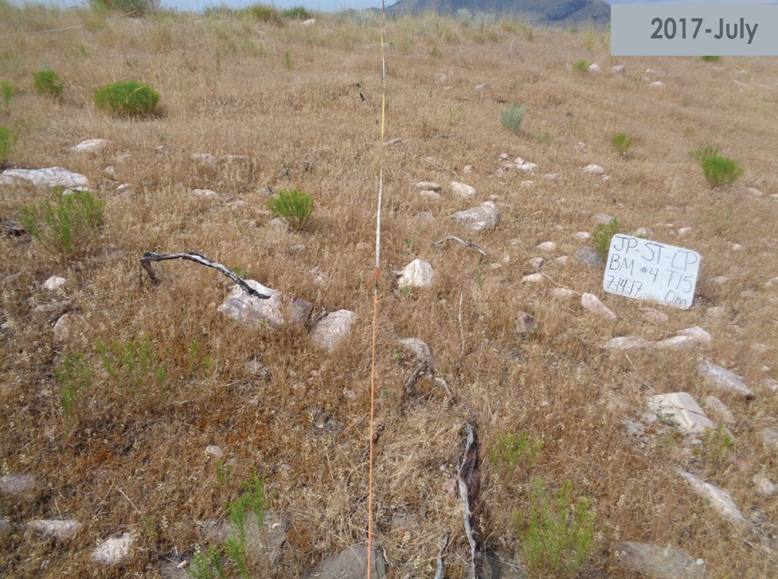
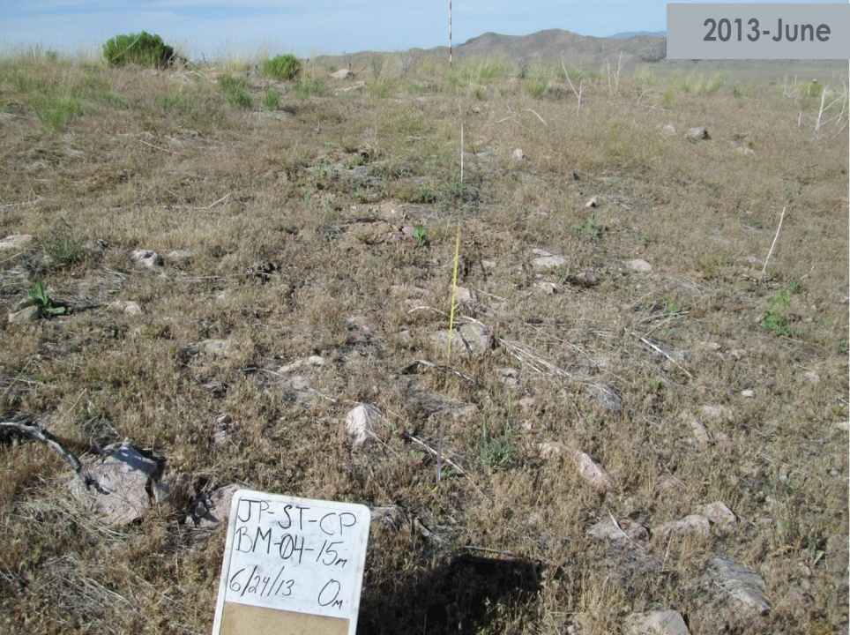
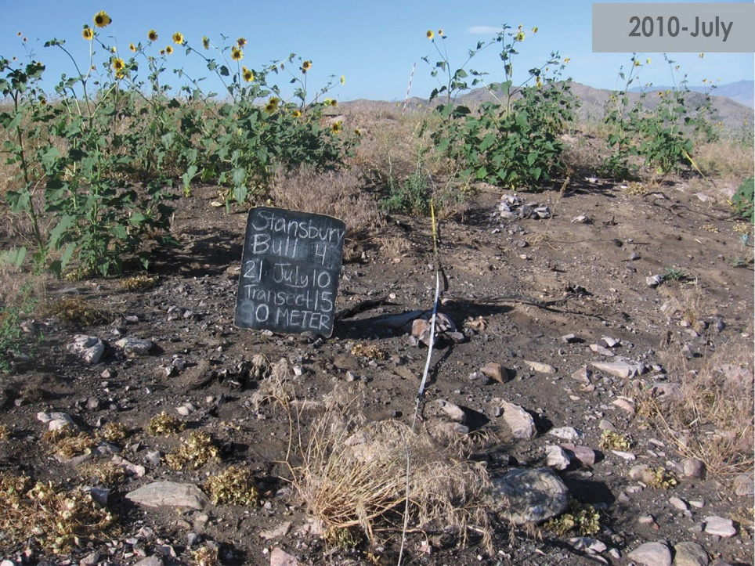
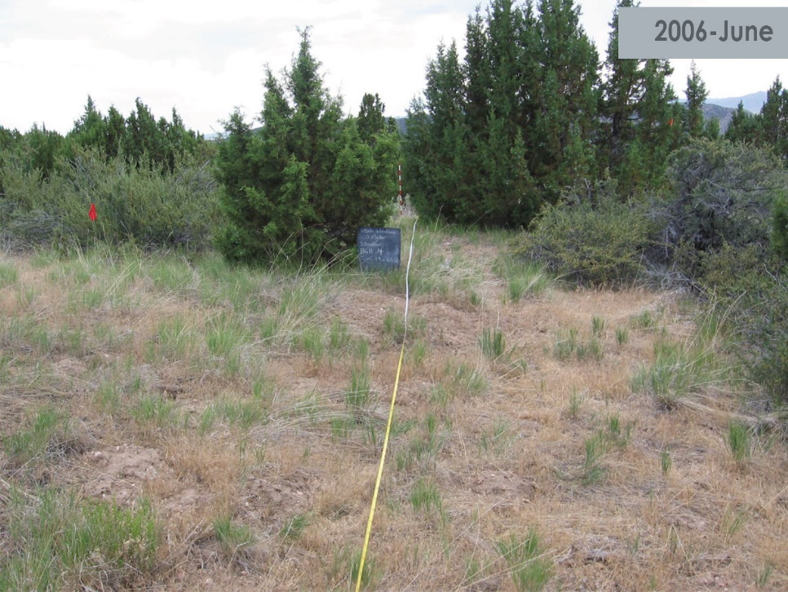
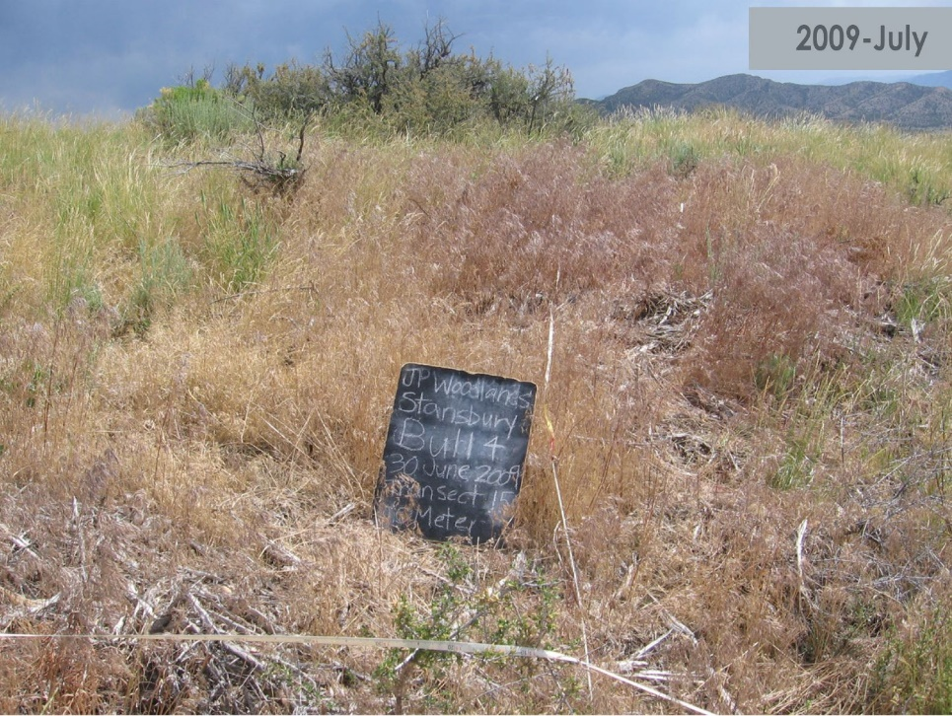
Stansbury Mastication
subplot 4
wildfire August 2009

Slide 9
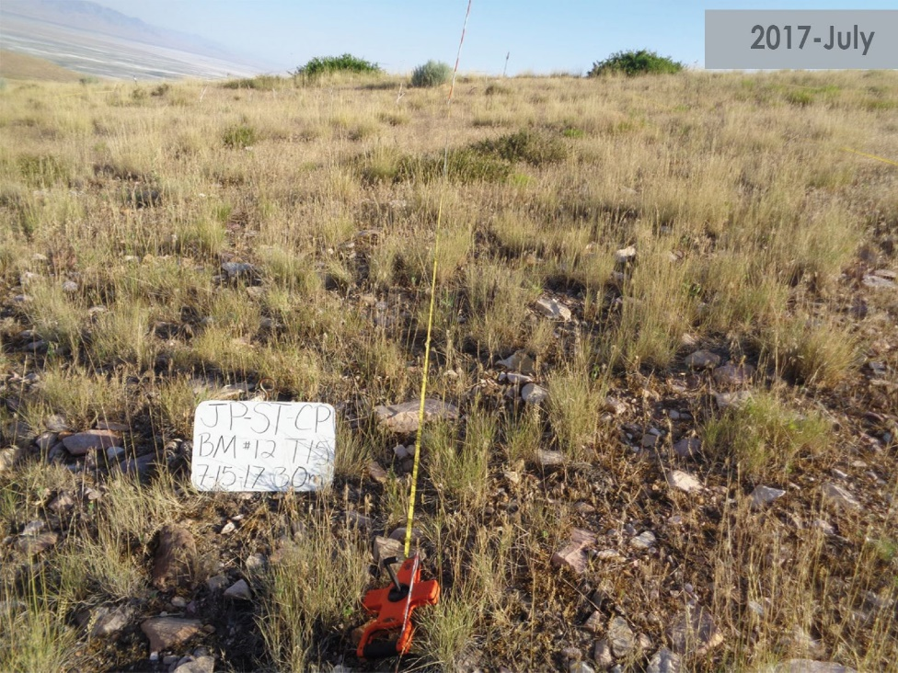
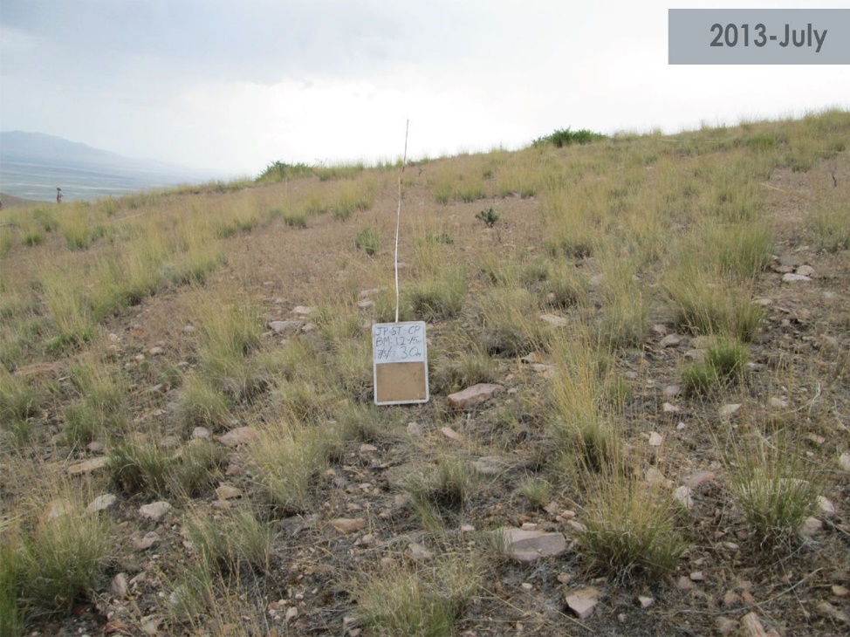
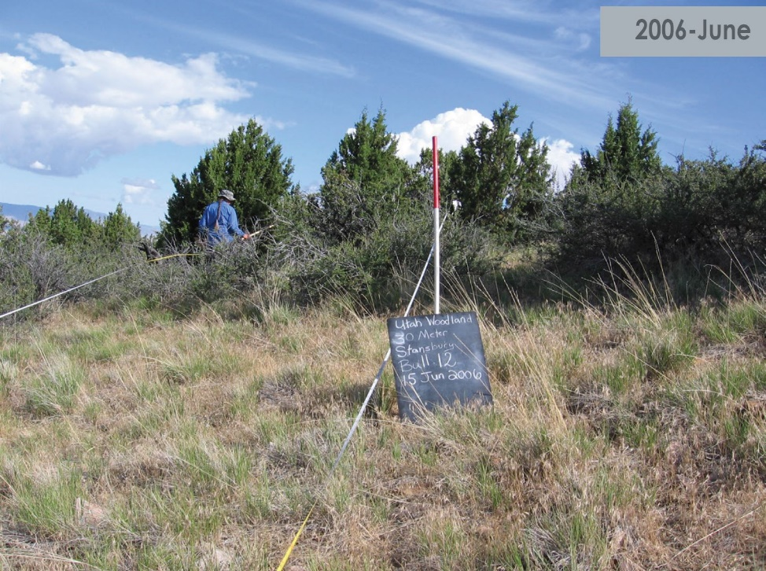
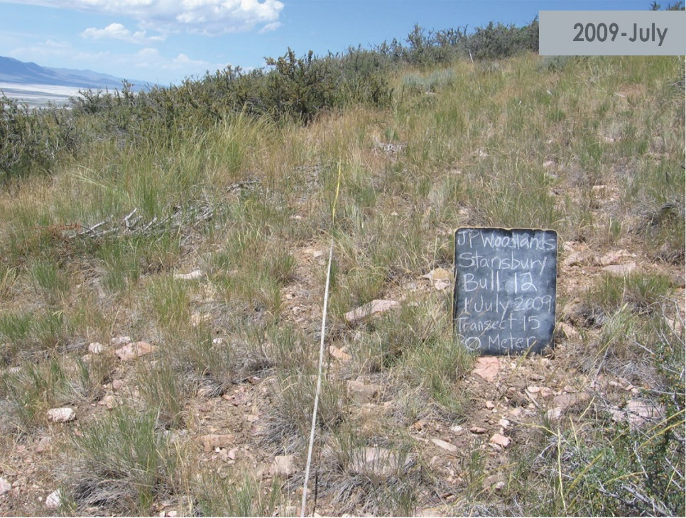
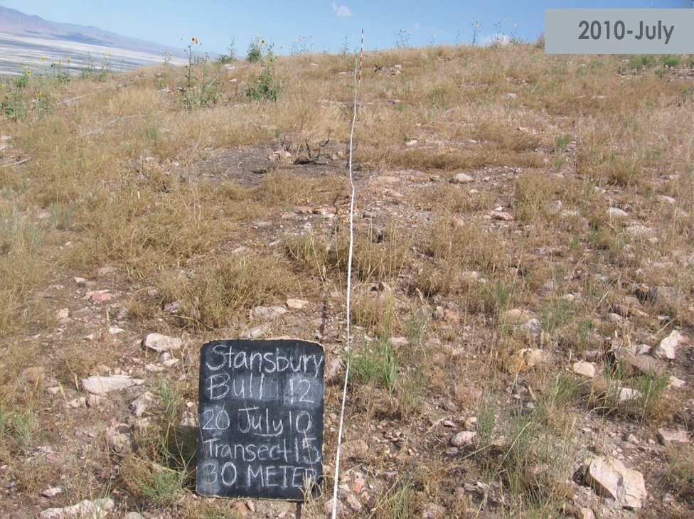
Stansbury Mastication
subplot 12
wildfire August 2009

Slide 10
Fuel Treatment Effectiveness: Stansbury Case Study

Slide 11
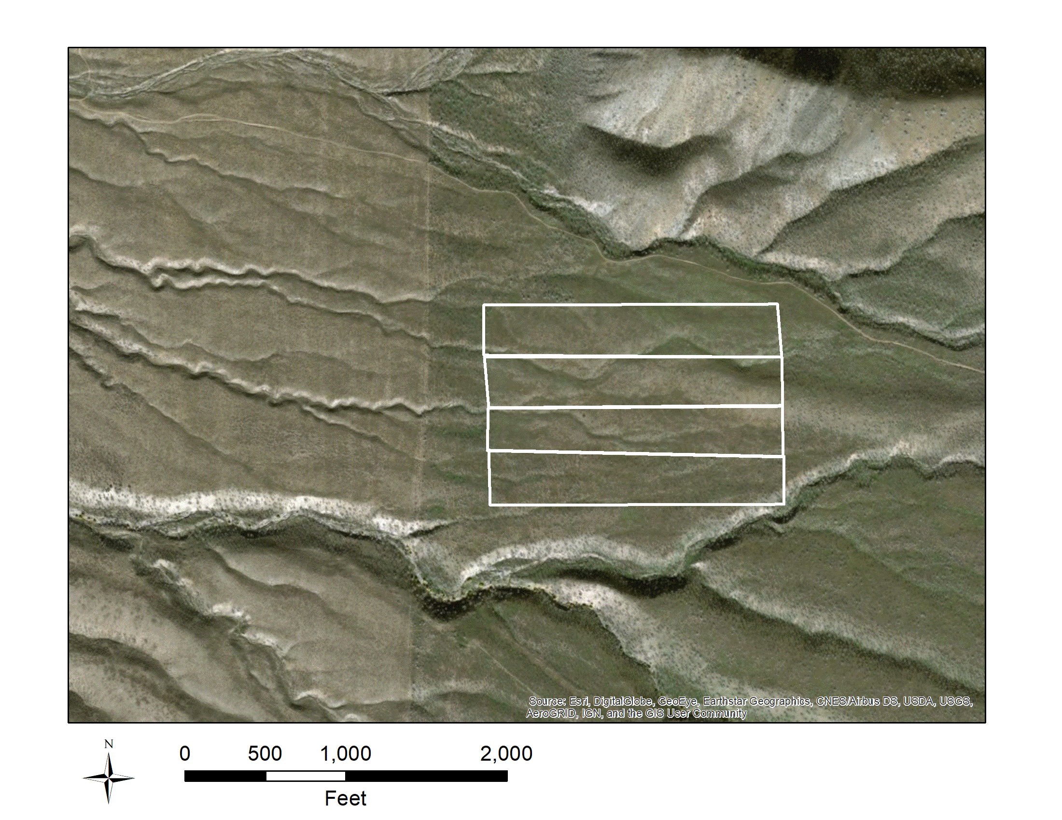
Stansbury Site Description
Treatments burned in 2009 Big Pole Fire
Elevation: 1700-1850 m
Slope 8-30%
Mountain big sagebrush and bluebunch wheatgrass, 12-14”
Utah juniper, Colorado pinyon
Prescribed burn
Mastication
Mechanical
Control (untreated)

Slide 12
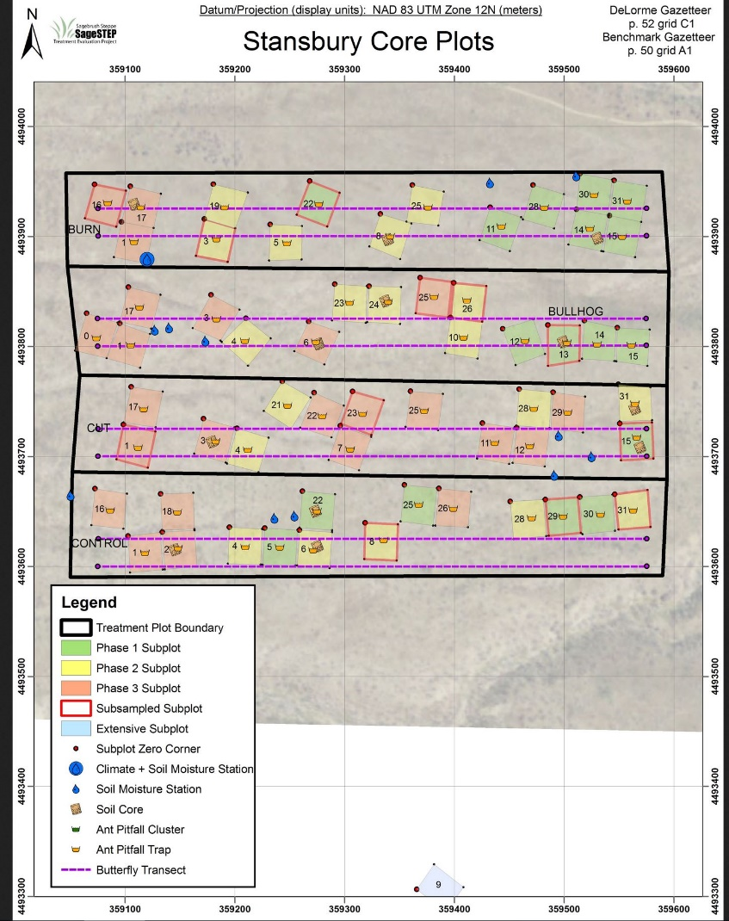
Stansbury Site Map

Slide 13
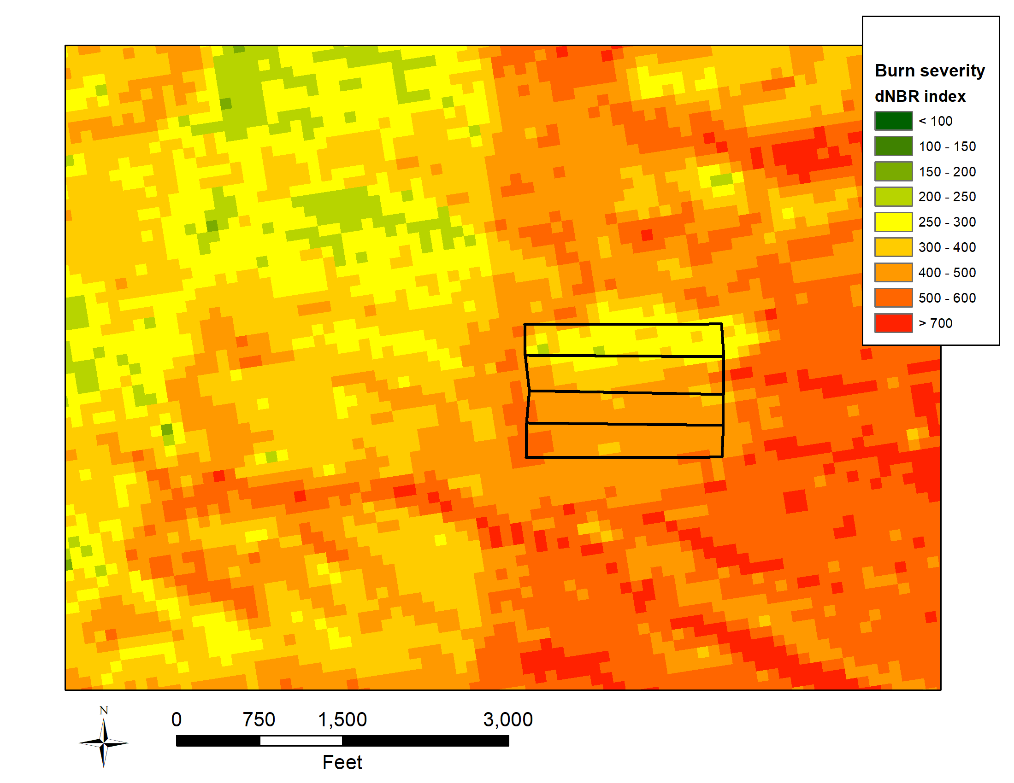
dNBR 1 Week Post-Fire
Prescribed burn
Mastication
Mechanical
Control

Slide 14
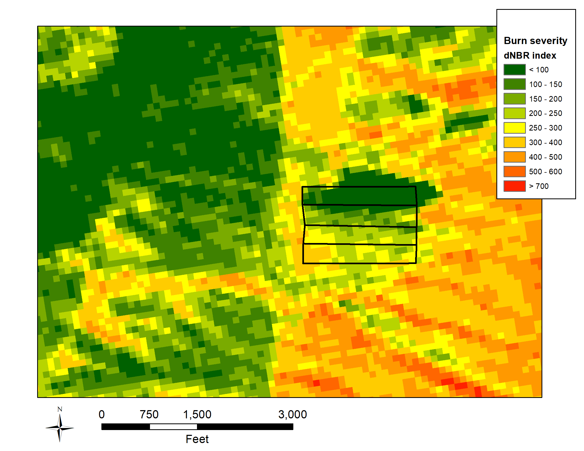
dNBR 1 Year Post-Fire
Prescribed burn
Mastication
Mechanical
Control

Slide 15
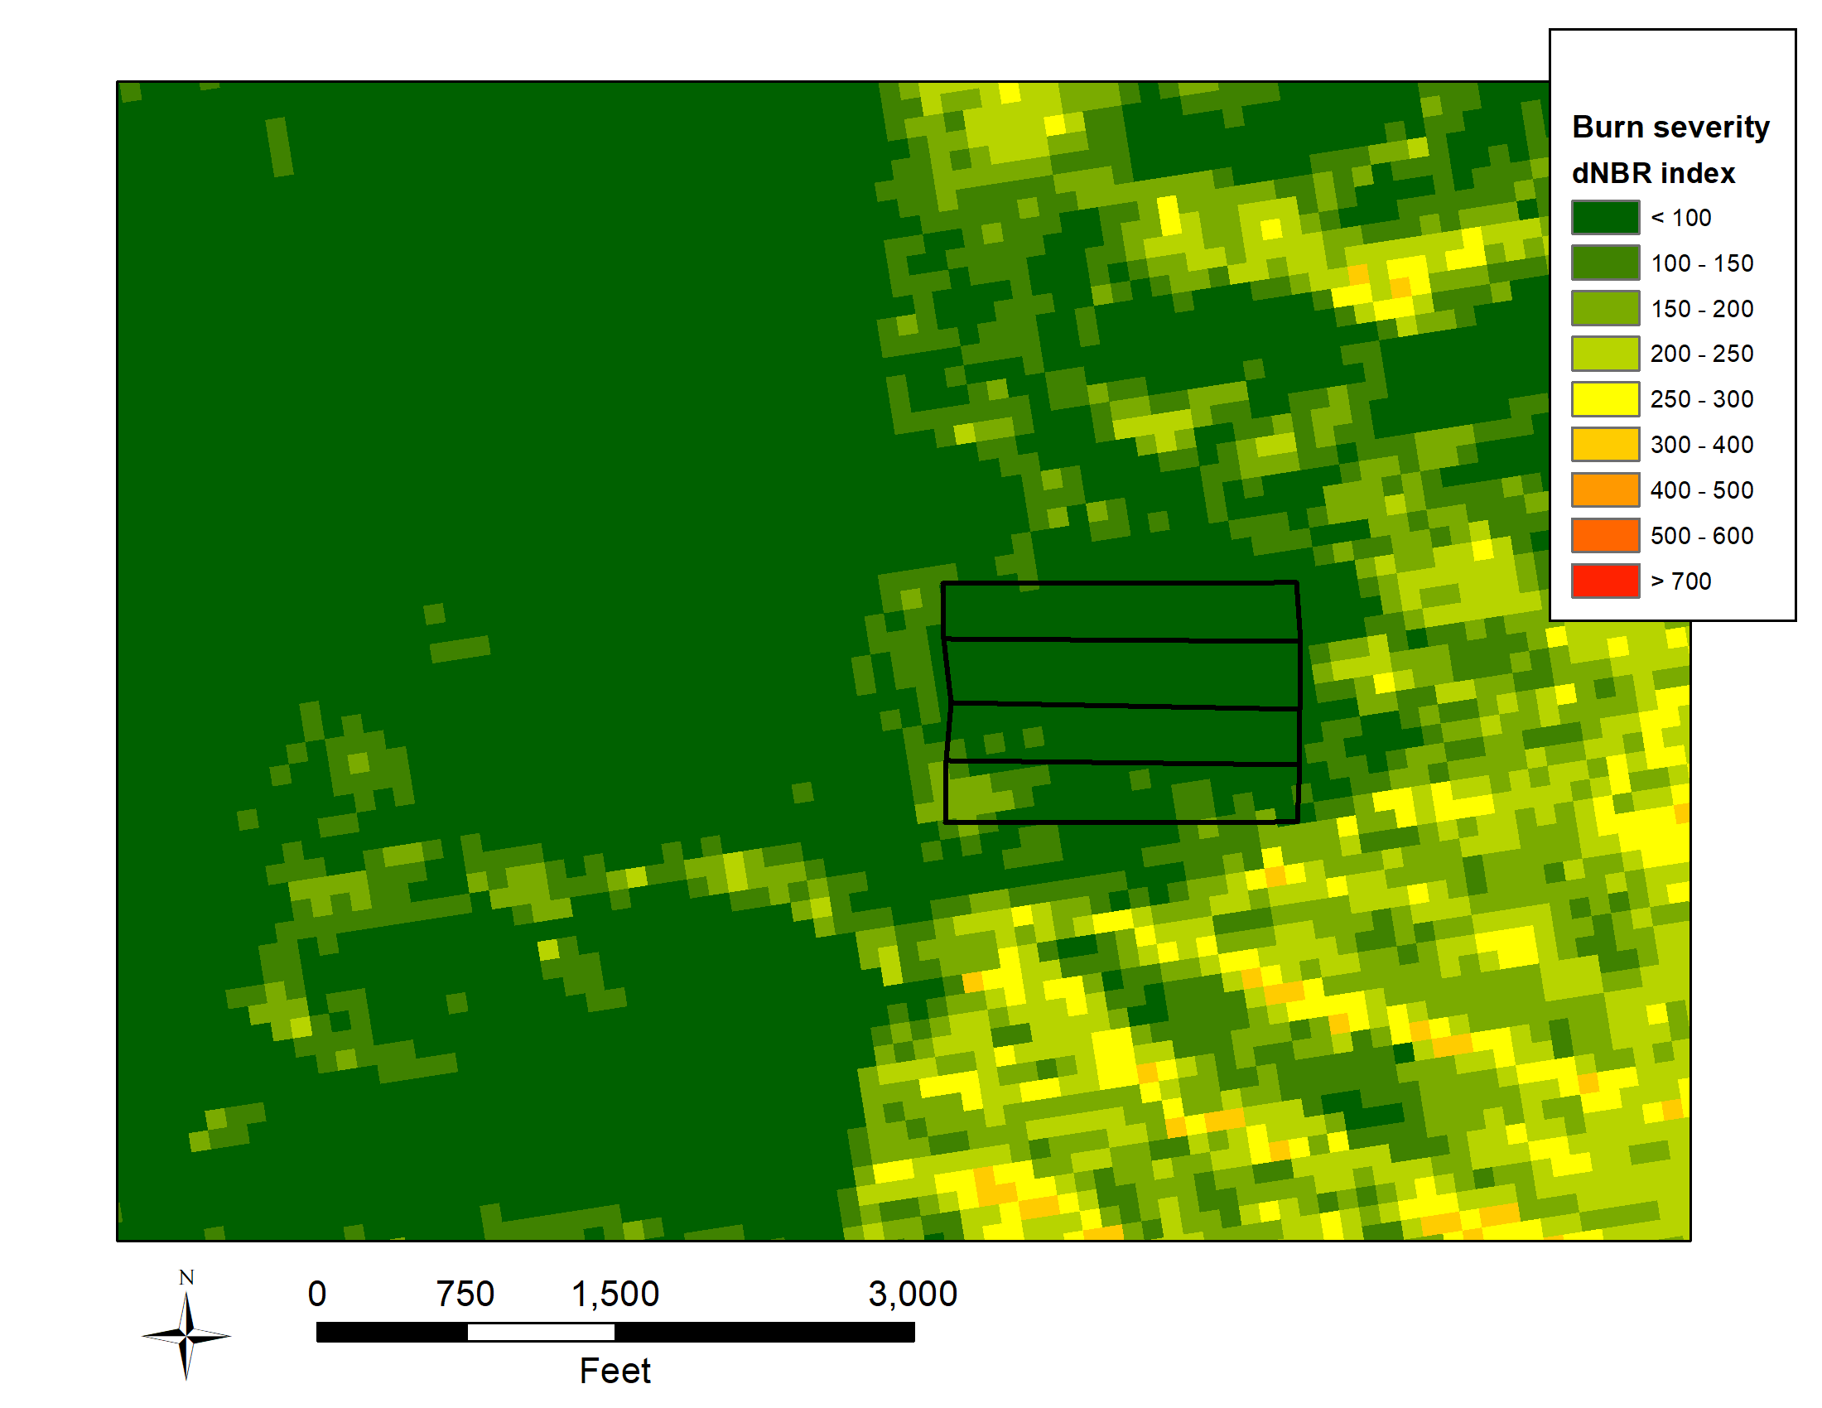
dNBR 2 Years Post-Fire
Prescribed burn
Mastication
Mechanical
Control

Slide 16
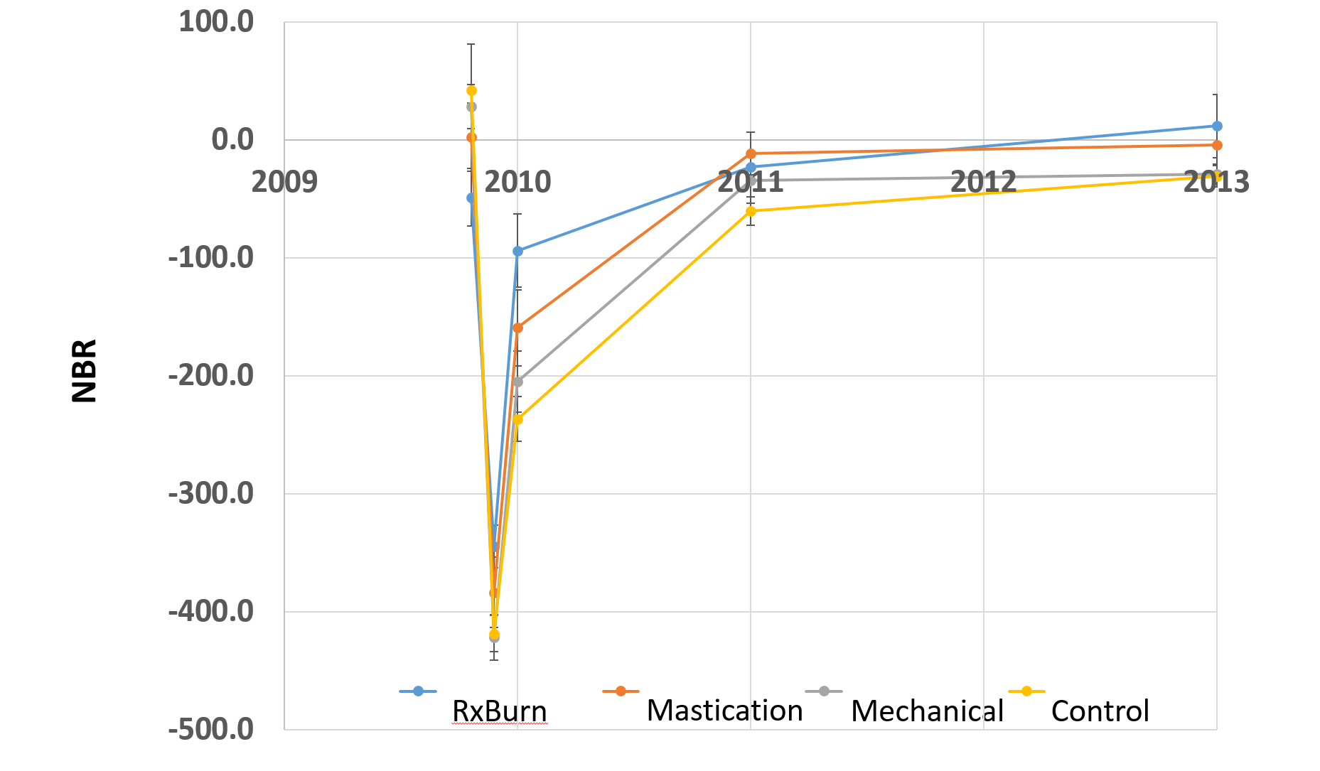
dNBR Over Time

Slide 17

Foliar cover at Stansbury 2013

Slide 18
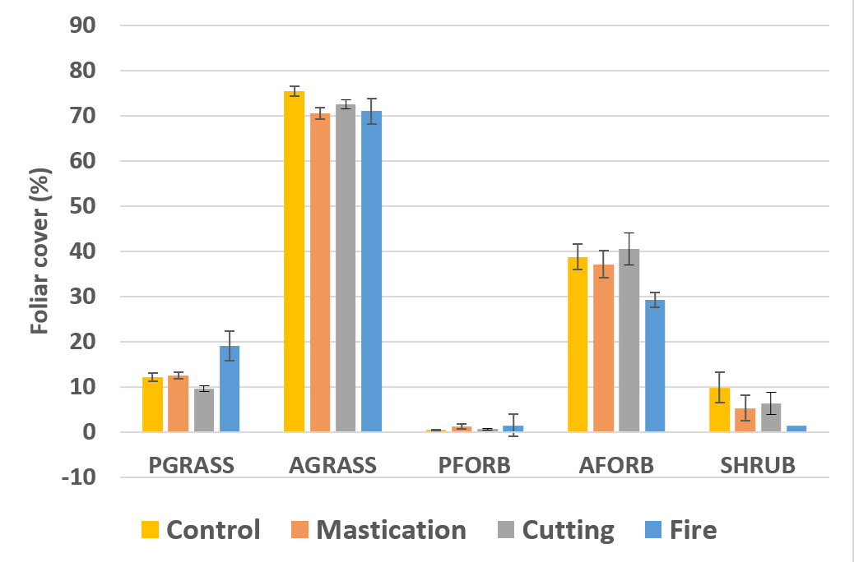
Foliar cover at Stansbury 2017

Slide 19
Changes in Fuel Loadings
and Treatment Longevity for Utah Sites
Notes:
ON, SC, GB—not stansbury

Slide 20
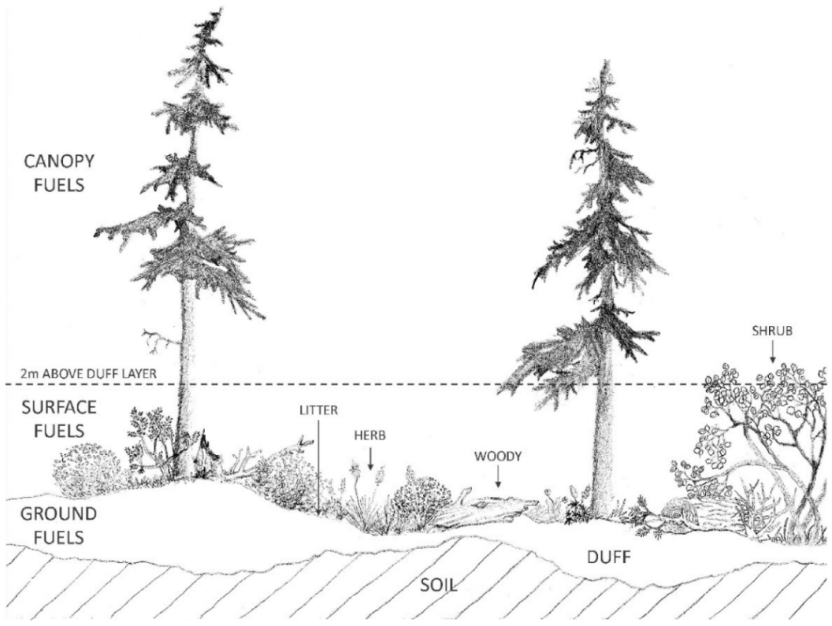
Changes in Fuel Loadings
Keane (2015)
Notes:
Changes in each fuel class
Greenville Bench, Scipio, Onaqui

Slide 21
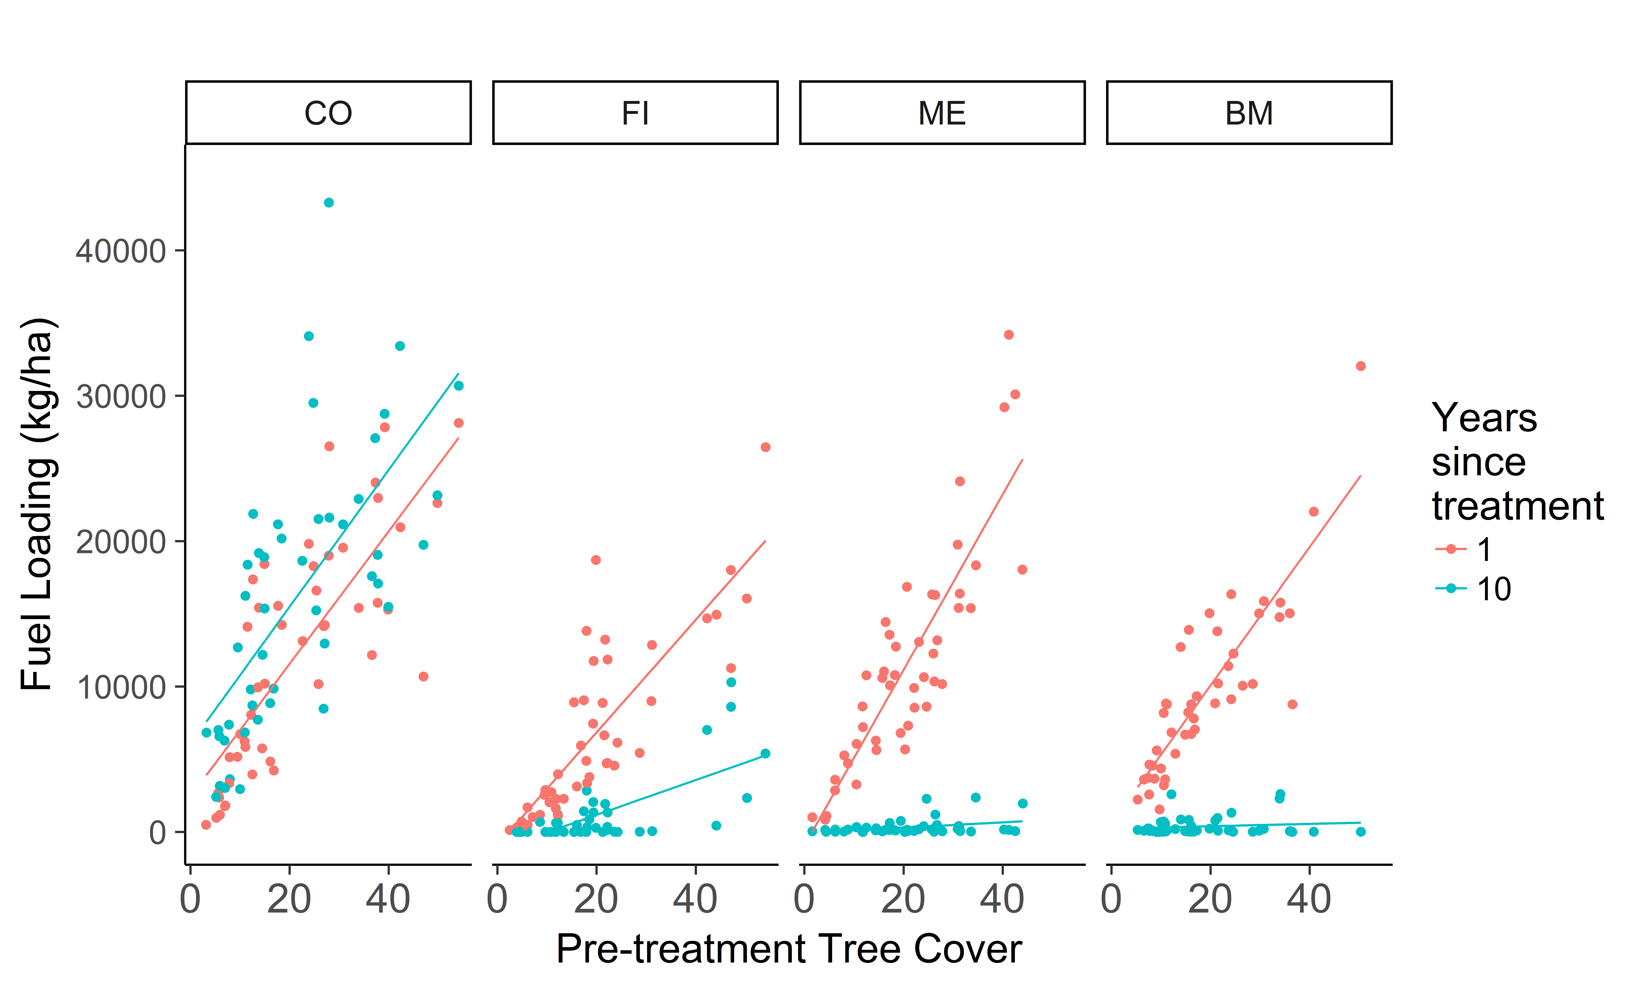
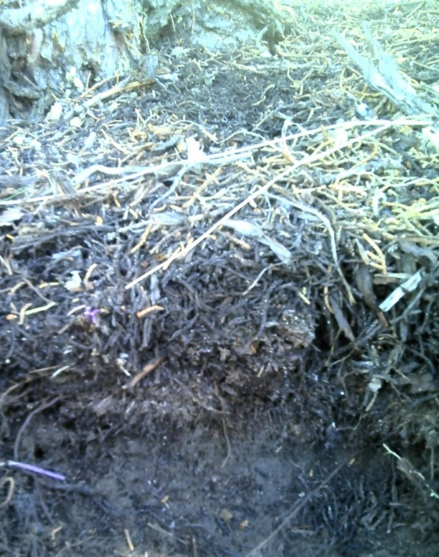
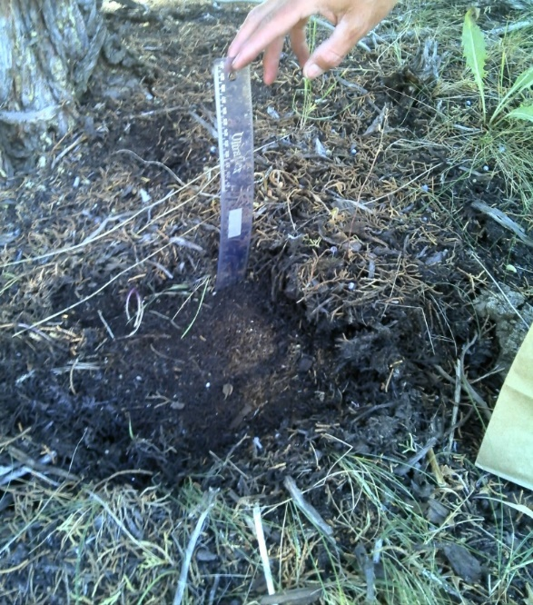
Tree Litter + Duff Load
Greater tree litter + duff loads
Higher fire severity
Lower understory diversity
(Weiner et al. 2016)
How do tree litter + duff loadings change over time?
Notes:
Weiner, N., Strand, I., Bunting, E., & Smith, K. (2016). Duff Distribution Influences Fire Severity and Post-Fire Vegetation Recovery in Sagebrush Steppe. Ecosystems, 19(7), 1196-1209.
But how do tree litter and duff change over time?

Slide 22
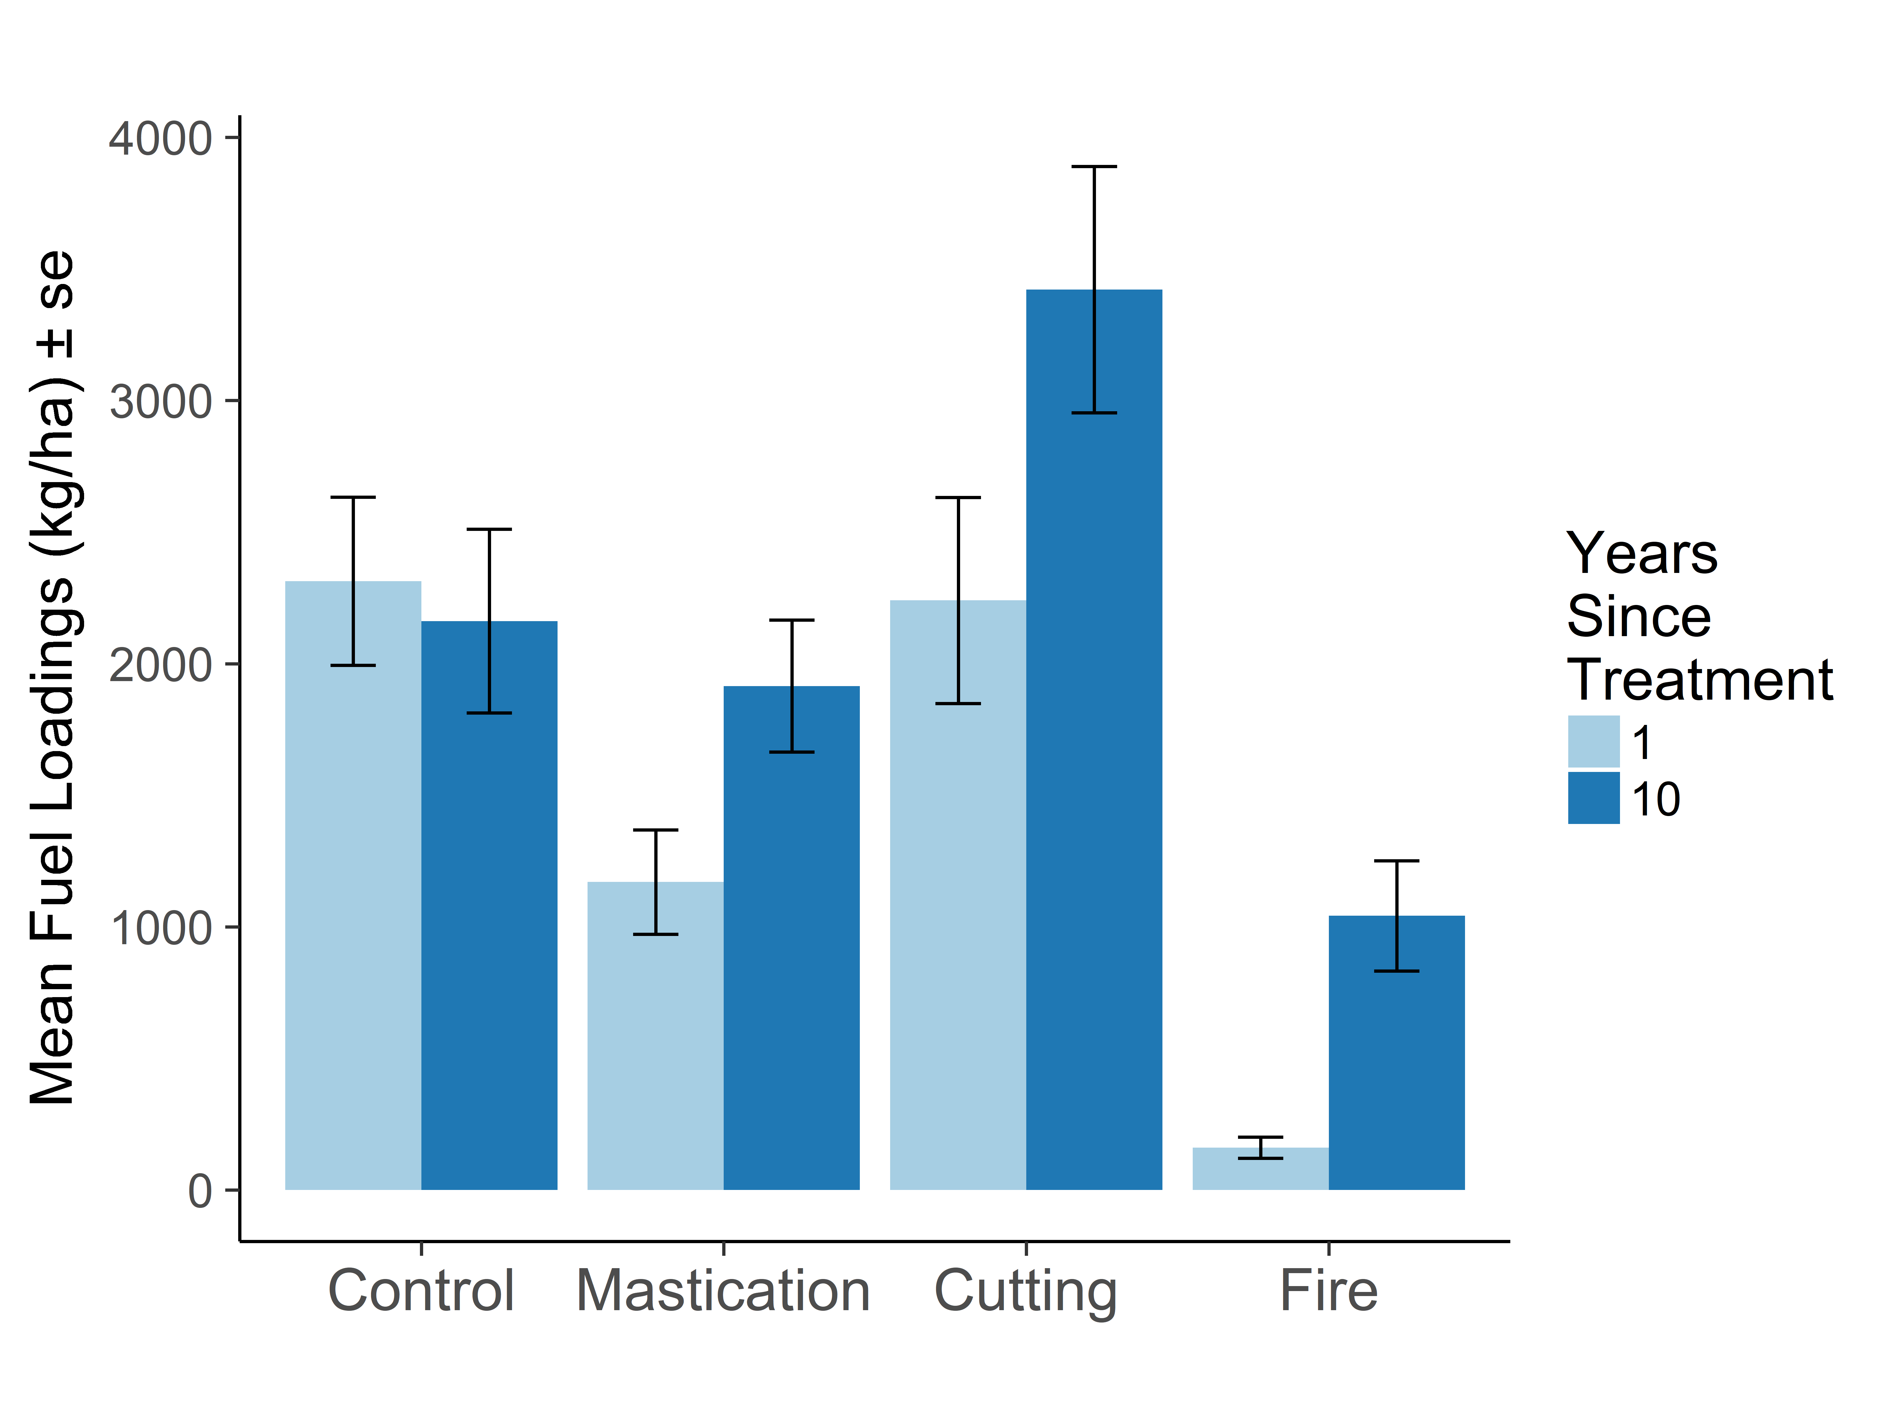
Shrub Loading

Slide 23
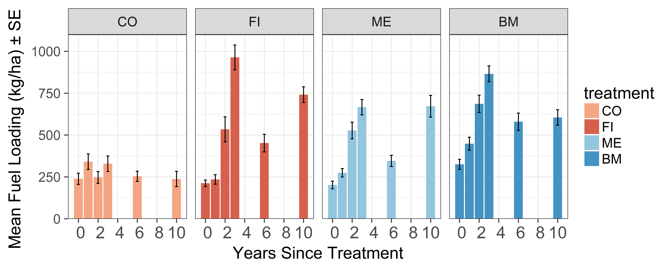
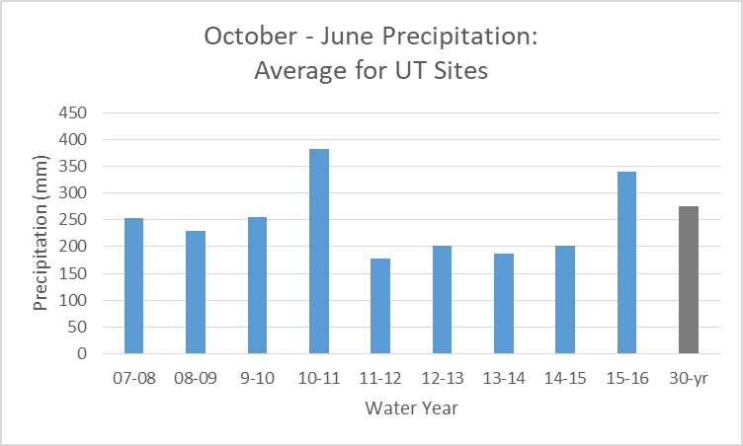
Total Herbaceous Loading

Slide 24
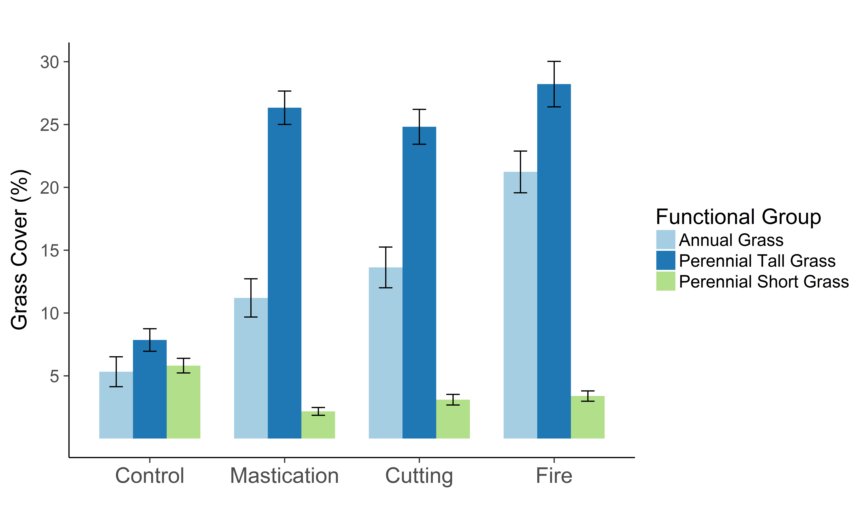
Grass Cover
10 years post-treatment

Slide 25
Downed Woody Debris
No clear trends in 10, 100, or 1000h DWD fuels
1h fuel loads were measured in masticated plots
Significant decreases in 1h fuels by 10 years post-treatment

Slide 26
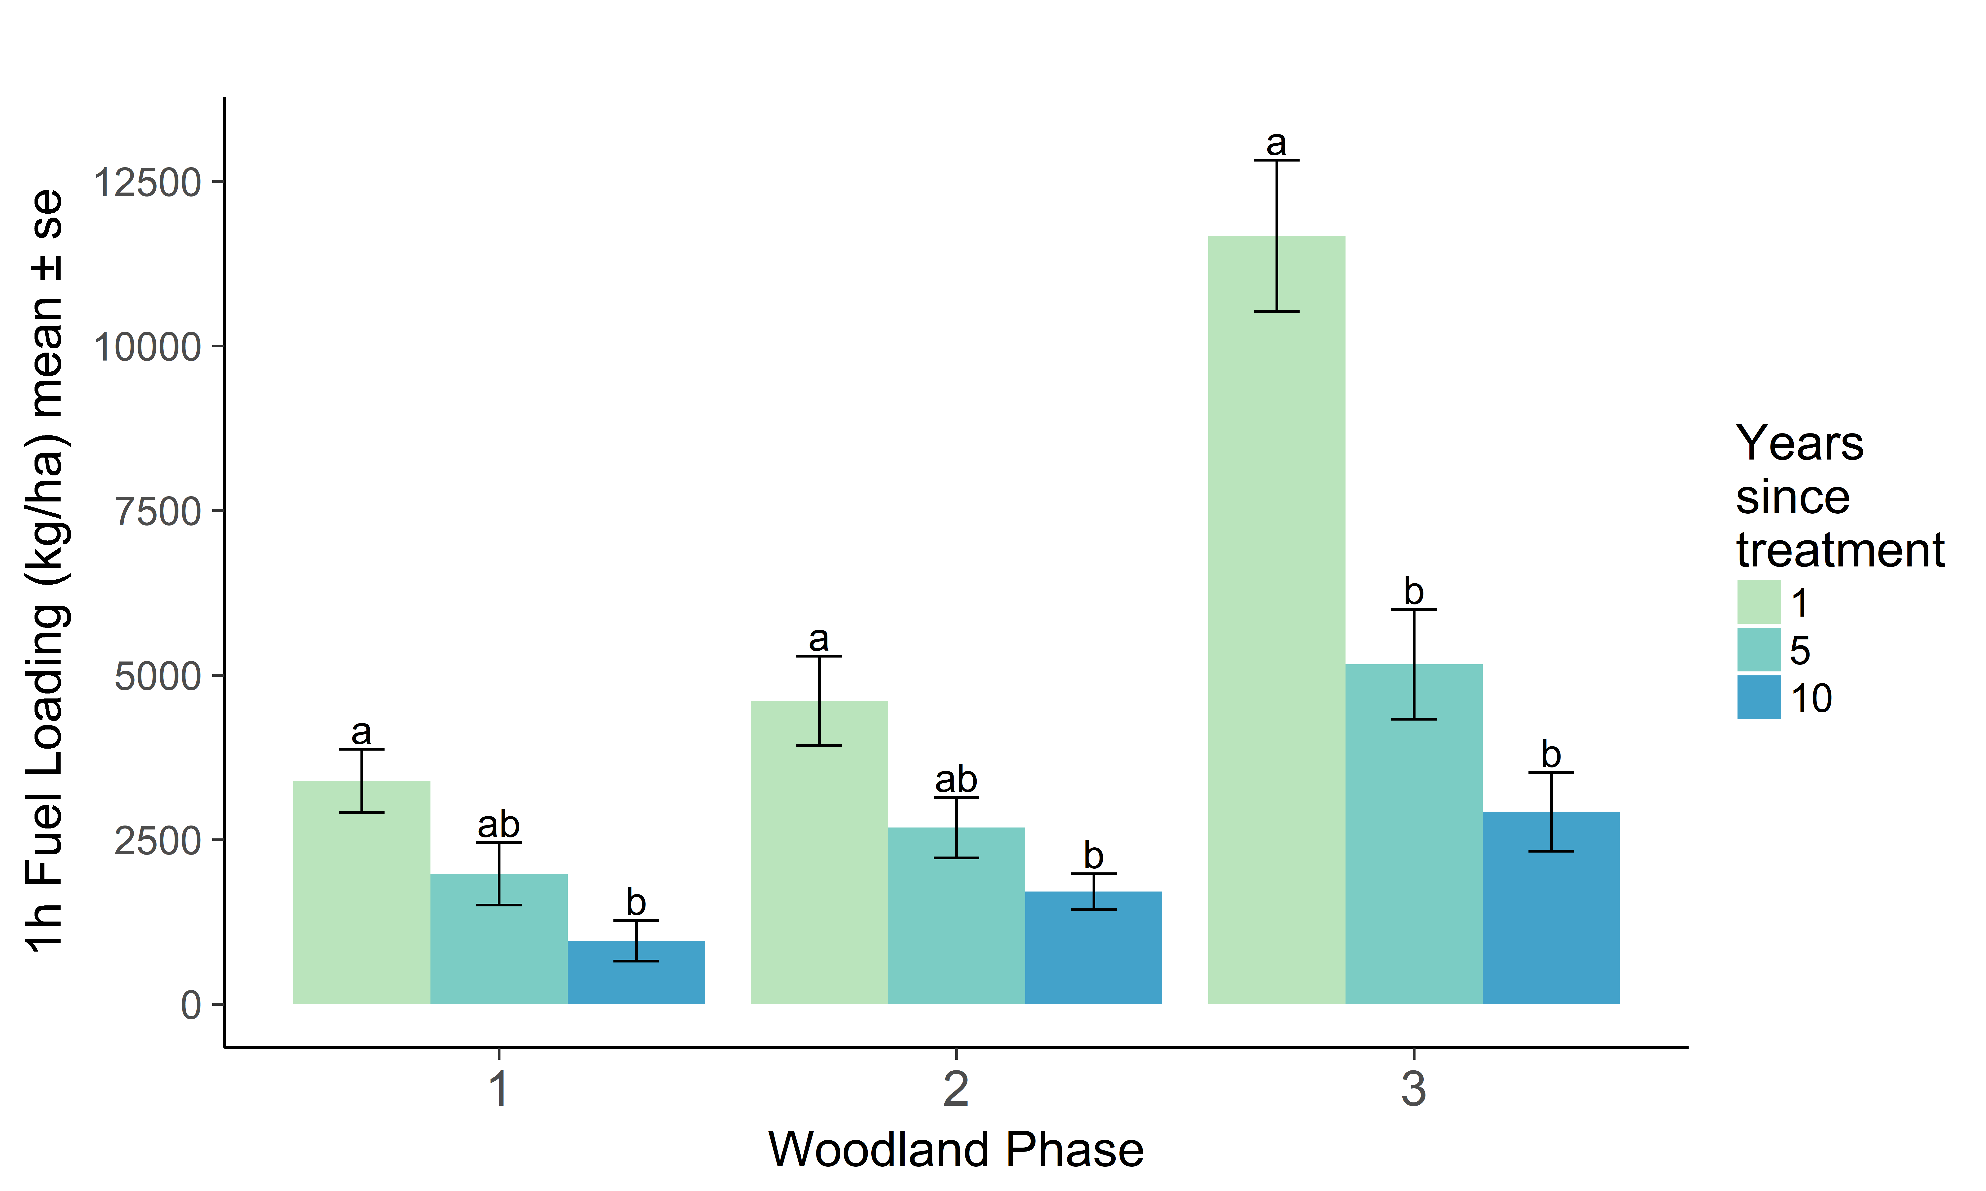
Masticated 1h DWD

Slide 27
Modeled Soil Heating
Fuel Loading (tons/acre) in Masticated Phase 3 Woodlands
 | 1 year | 5-6 years | 10 years
1h dwd | 5.21 | 2.3 | 1.31
10h dwd | 2.9 | 2.9 | 2.9
100h dwd | 1.38 | 1.38 | 1.38
1000h dwd | 0.29 | 0.29 | 0.29
herbaceous ld | 0.04 | 0.35 | 0.22
shrub ld | 0.09 | 0.49 | 0.89
Modeled soil heating in First Order Fire Effects Model (FOFEM)
10, 100, 1000h fuels held constant
1h decreases
Herbaceous and shrub increases
Fuel moisture: Very Dry
Notes:
FOFEM models soil heating

Slide 28
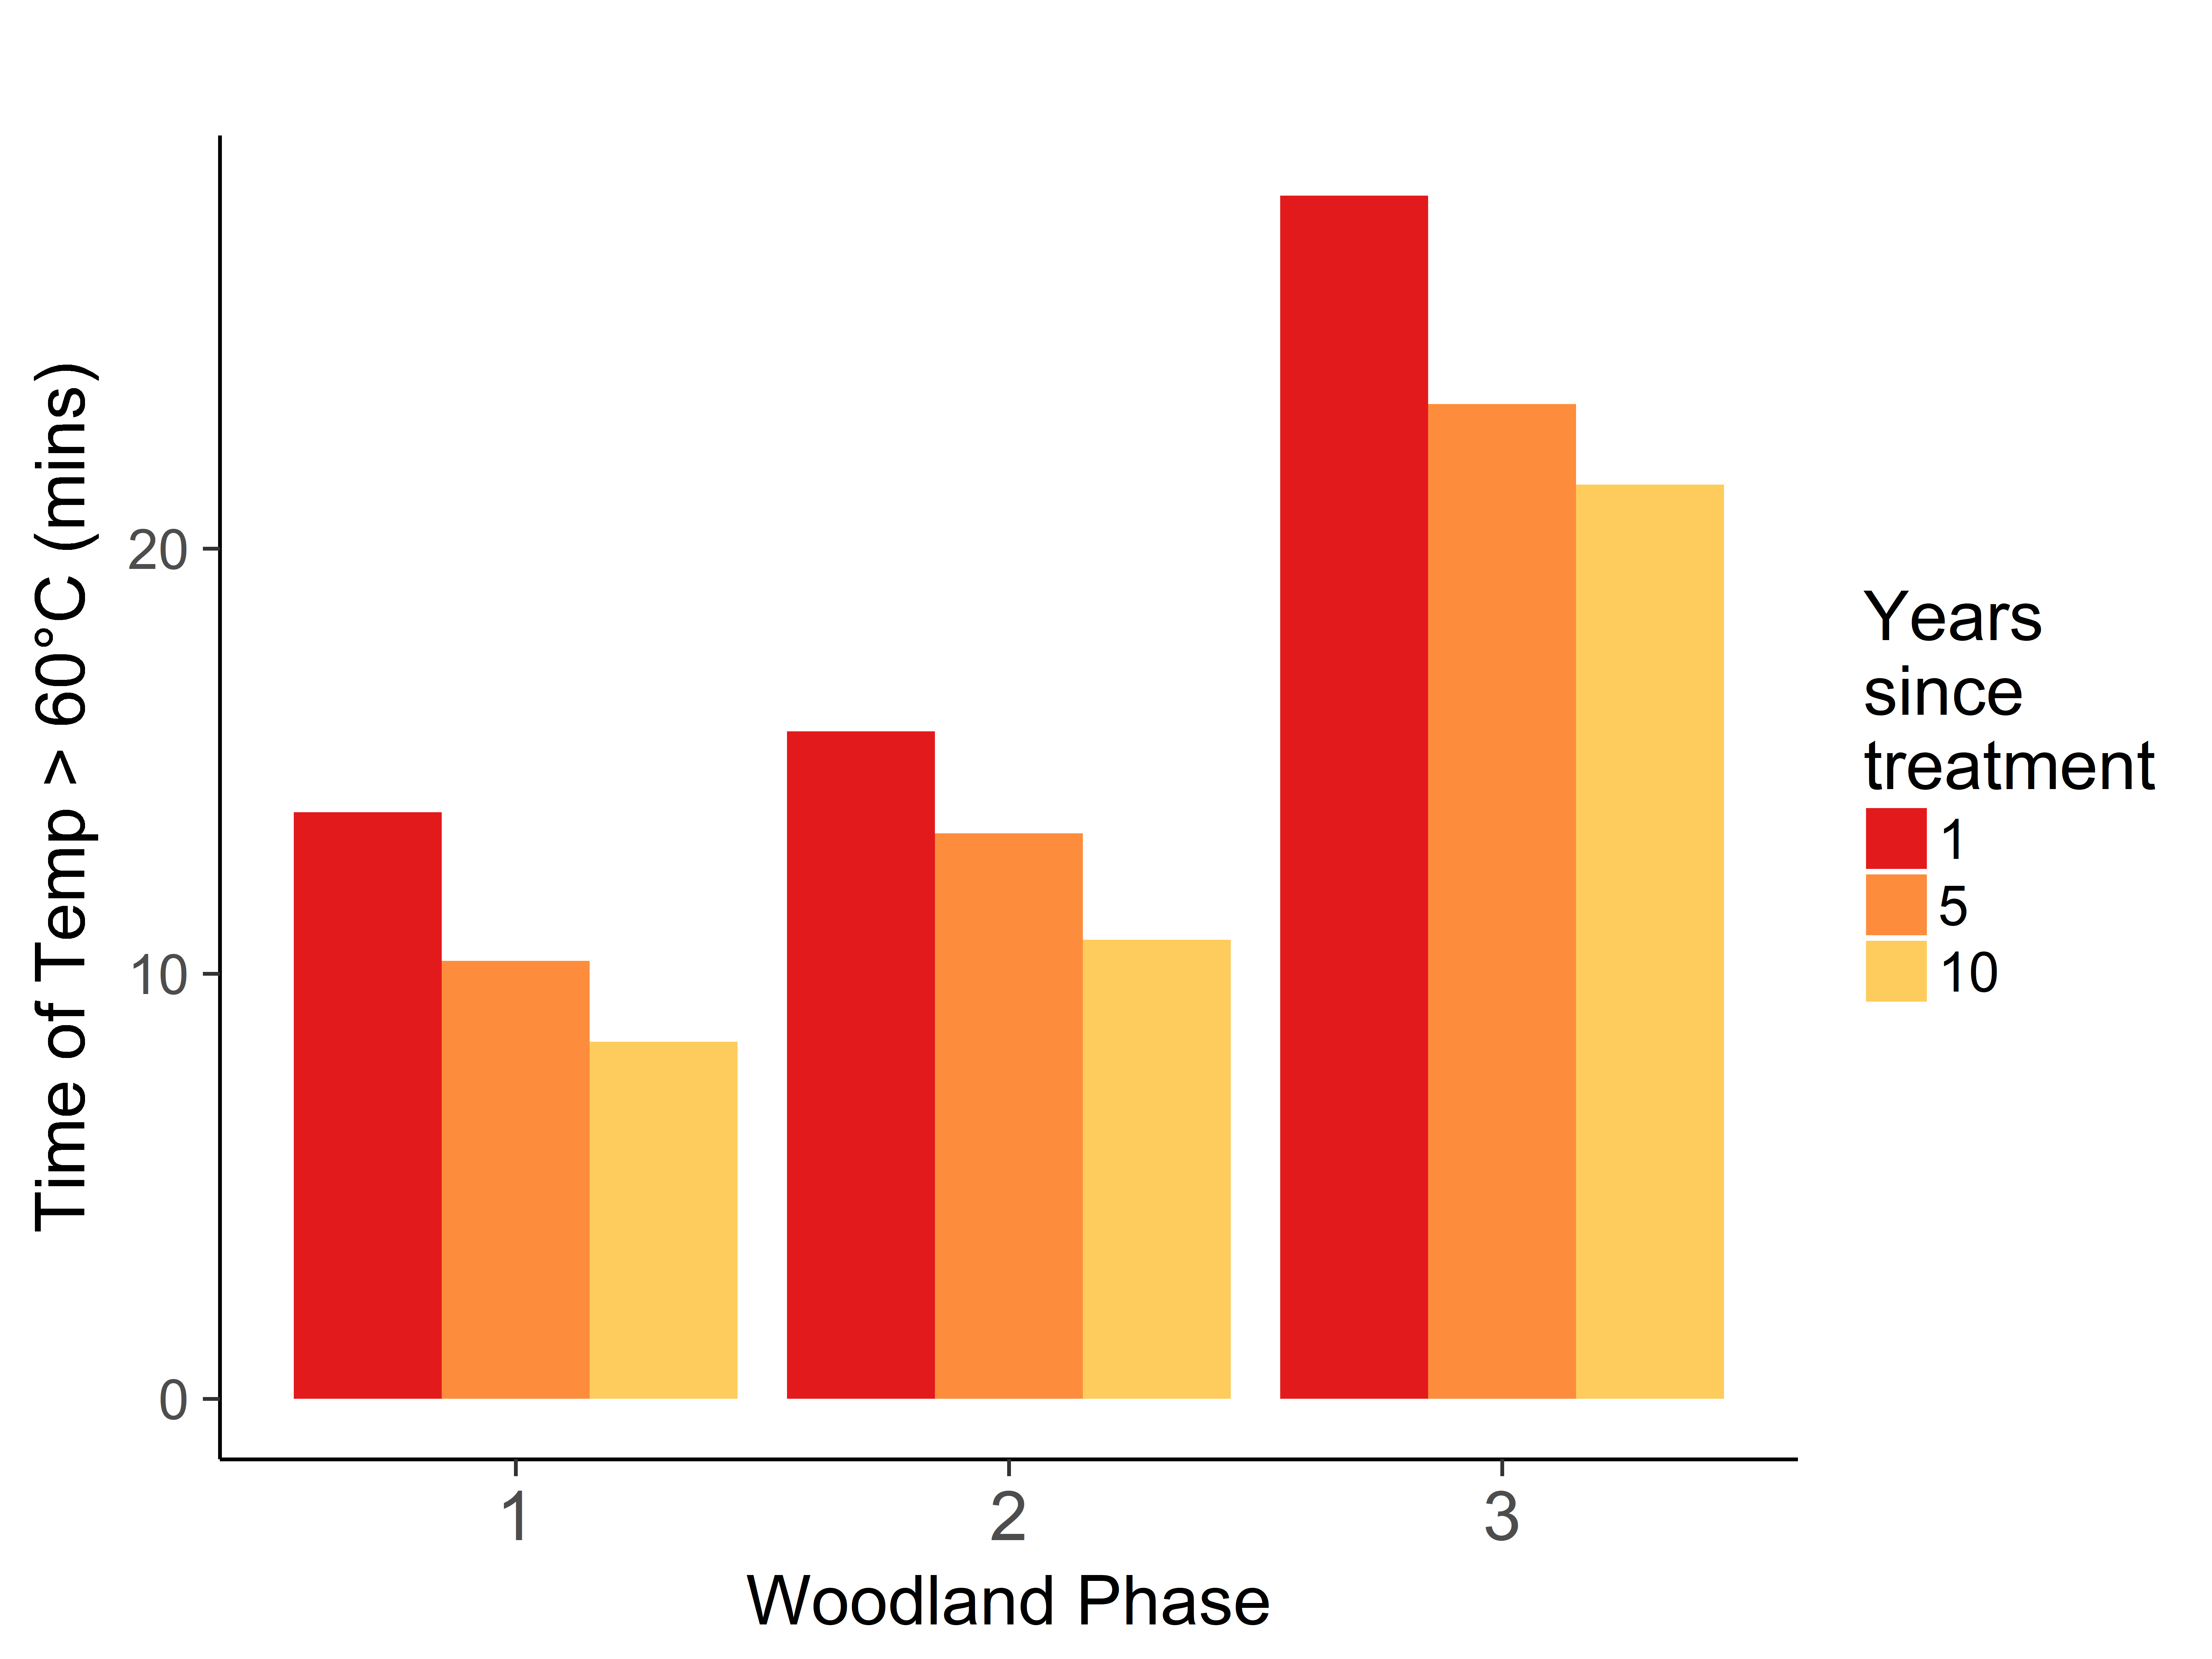
Soil Surface Heating
Notes:
Sensitive to changes in 1h DWD—differences between phases and over time
Less sensitive to increases in herbaceous and shrub fuels

Slide 29
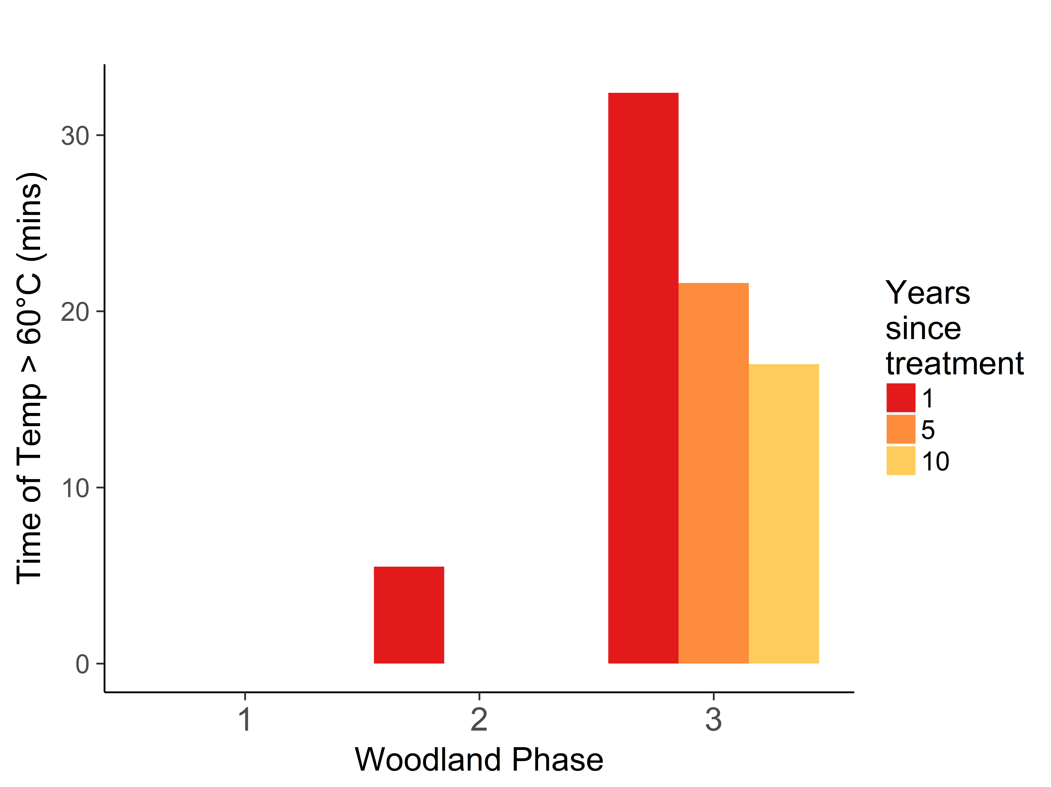
Soil Subsurface (1 cm depth)
Notes:
Subsurface soil heating threshold between phases 1 and 2 was removed after decomposition of 1h fuels over 5 years

Slide 30
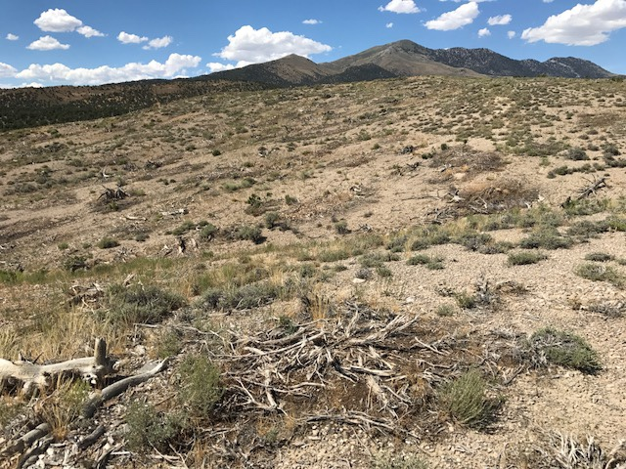
Soil Heating Patchiness
FOFEM is a point model, but masticated fuels have high spatial variability
Soil heating varies spatially
Notes:
Binary model– either duff model, or all other surface fuels
But in real world—duff is usually under masticated fuels
FOFEM ASSUMPTION – “Before the Campbell soil heating model is initiated the FOFEM model uses two alternative approaches to simulate the amount of heat delivered to the soil surface. The non-duff model assumes radiant heating (simulated in the Burnup model) from the flaming combustion of the woody, litter, herbaceous and shrub fuelbed components heats the soil surface. Alternatively, the duff model assumes radiant and conductive heat from only the burning duff/organic soil horizons heats the soil surface.”

Slide 31
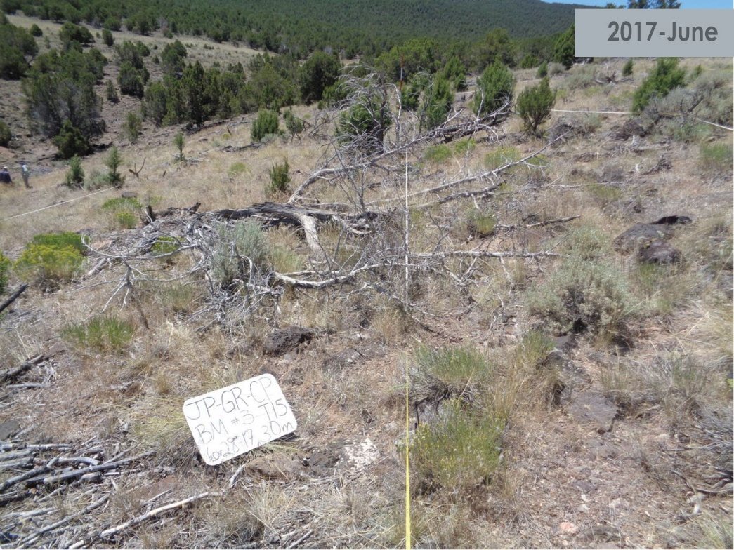
Treatment Longevity—Tree Recovery
Limited research on treatment longevity in pinyon-juniper woodlands
Bates et al. (2017) estimated that western juniper cutting treatments (trees >20 cm) at Steens Mountain had a treatment longevity of 25-30 years
Based on the goal of avoiding decreases in understory cover

Slide 32
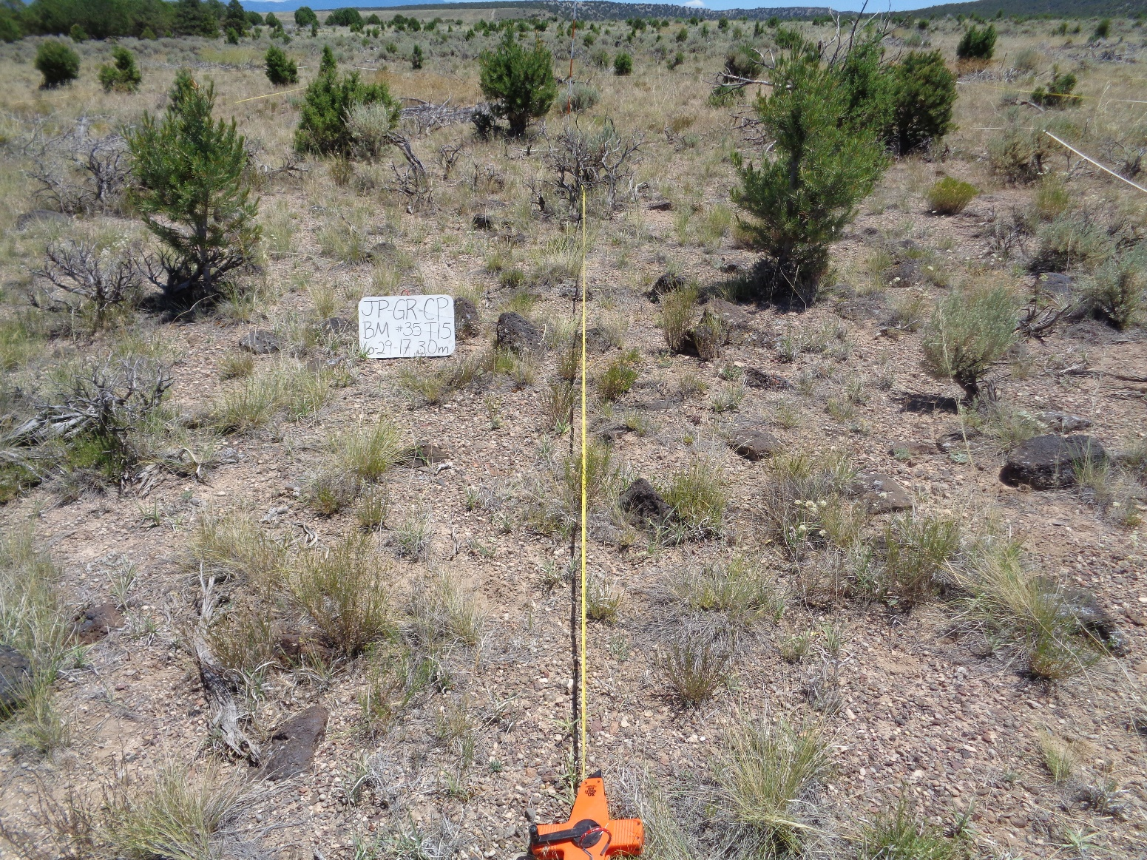
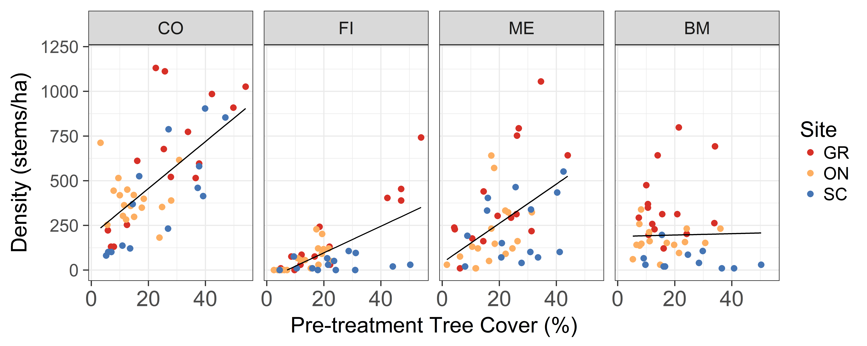
Density of Trees > 5cm

Slide 33


Tree Cover

Slide 34

PJ Reduction—Treatment Longevity
SageSTEP woodland sites
▲ represents western juniper site
● represent Utah juniper/single-leaf pinyon sites
■ represent Utah juniper/Colorado pinyon sites
Notes:
For this presentation, we focused on the Utah sites, but it’s important to remember SageSTEP is a larger project with woodland sites in several western states.
SageSTEP project is a unique opportunity to evaluate and compare treatment longevity across different types of pinyon-juniper woodlands/regions. Continued long-term monitoring will capture when the understory starts to decline in response to competition with growing trees.

Slide 35
Main Points
Lower fire severity in RX burn and mastication treatments—Big Pole Fire
Tree litter + duff decreases substantially in all treatments
Perennial grass cover is 25-30% in all treatments (<15% in control)
1h masticated fuels decrease significantly over time
Modeled soil heating is sensitive to decreases in 1h fuels
*Management Implication—shred high percentage of fuels to 1h fuel class?
Tree density depends on pre-treatment tree cover (except for mastication?); but tree cover < 2%

